Slide 1

NMC studio PowerPoint template
Purple
newmediacentre.tudelft.nl
+31 (0)15 278 5082
newmediacentre@tudelft.nl

Slide 2
To make the studio recordings as enjoyable as possible for everyone, we have come up with some "rules."
Submit the powerpoint and script no later than 3 business days before the recording so we can have everything in place in time for your recording.
To: newmediacentre@tudelft.nl
Minor adjustments, such as textual changes, can be made on the day of the recording. Unfortunately, this has to be done within the booked recording time.
Make sure you have read through the script texts before you come to us for the shoot.
Studio time is valueable for you and for us. Let’s start on time.
And of course ‘Have Fun’!

Slide 3
What’s this?
This is an example for an online presentation to be used in an educational video recording at the NewMedia Centre.
Please take some time to READ these slides or even better:
WATCH them in Presentation mode.
If you need help with your presentation:
Contact your course team e-learning developer or NMC: newmediacentre@tudelft.nl

Slide 4
Copyright free photo websites
Add images to your presentation. Look at websites such as:
www.pexels.com
www.pixabay.com
www.unsplash.com

Slide 5
Text
Title Text (Calibri Light 34pt)
Standard text (Calibri standard 24pt)
Calibri Bold (Calibri Bold 24pt) (Only used for highlights en sub-headers)
Calibri Italic (Calibri Italic 24pt)
1st Secondary text (Calibri 20pt)
2nd Secondary text (Calibri 16pt)
Image credits (Calibri Light Italic 24pt) the color may be changed to improve visibility but should not draw attention.
Standard text color is not black but:
Background color is not WHITE but:
#33333 or R=42 G=42 B=42
#FFFFF or R=240 G=240 B=240
Colors
On the left you see the color pallette.
Try to use one “extra” color for a presentation or subject!
Colors used in this example presentation are just to show possibilities.
Some combinations will not work!!
When in doubt or if you want help, contact your course team e-learning developer or the NMC
Title Text (Calibri Light 34pt)
Standard text (Calibri standard 24pt)
Calibri Bold (Calibri Bold 24pt) (Only used for highlights en sub-headers)
Calibri Italic (Calibri Italic 24pt)
1st Secondary text (Calibri 20pt)
2nd Secondary text (Calibri 16pt)
Image credits (Calibri Light Italic 24pt) the color may be changed to improve visibility but should not draw attention.
Standard text color is not black but:
Background color is not WHITE but:
Basic colors
Extra colors
#33333 or R=42 G=42 B=42
#FFFFF or R=240 G=240 B=240

Slide 6
Colors
On the left you see the color pallette.
Try to use one “extra” color for a presentation or subject!
Colors used in this example presentation are just to show possibilities.
Some combinations will not work!! When in doubt or if you want help, contact your course team e-learning developer or the NMC
Basic colors
Extra colors

Slide 7
Numbers you can use

Slide 8
This is considered to be a very long title for a powerpoint presentation
If in someway your story or summarizing does not fit in this box without changing the font size or line height, then your story is most likely too long for a powerpoint presentation slide. It most likely should be cut into more slides. Please keep in mind that most people do not have the ability to read and listen simultaneously so they will either listen to you or read the text.
Avoid slides like this one whenever possible!

Slide 9
Best practise
Keep lists short
Highlight a sentence or word from your lecture
Tell where detailed information can be found
  This can be a download reader
  Or a digital handout
  Or a book or website
Revice your content for web publication

Slide 10

Text
Title Text (Calibri Light 34pt)
Standard text (Calibri standard 24pt)
Calibri Bold (Calibri Bold 24pt) (Only used for highlights en sub-headers)
Calibri Italic (Calibri Italic 24pt)
1st Secondary text (Calibri 20pt)
2nd Secondary text (Calibri 16pt)
Image credits (Calibri Light Italic 24pt) the color may be changed to improve visibility but should not draw attention.
Standard text color is not black but:
Background color is not WHITE but:
#33333 or R=42 G=42 B=42
#FFFFF or R=240 G=240 B=240
Colors
CHANGE IMAGE/PUT IMAGE
On the left you see the color pallette.
Try to use one “extra” color for a presentation or subject!
Colors used in this example presentation are just to show possibilities.
Some combinations will not work!!
When in doubt or if you want help, contact your course team e-learning developer or the NMC
1
If necessary, delete the existing image using the 'Delete' button. Click the icon to insert a new image. (see example below).
2
Select the desired image and click 'Insert'.
Insert
3
To scale or crop the image, go to the 'Picture Tools - Format' tab and click the 'Crop' button. Scale the image the dots and the image frame with the c with corners.
Title slide
Basic colors
Extra colors
Contact your course team e-learning developer or NMC for a custom title slide
Crop
Dr. John Doe
DO YOU NEED HELP?
Contact your course team e-learning developer or NewMedia Centre!

Slide 11
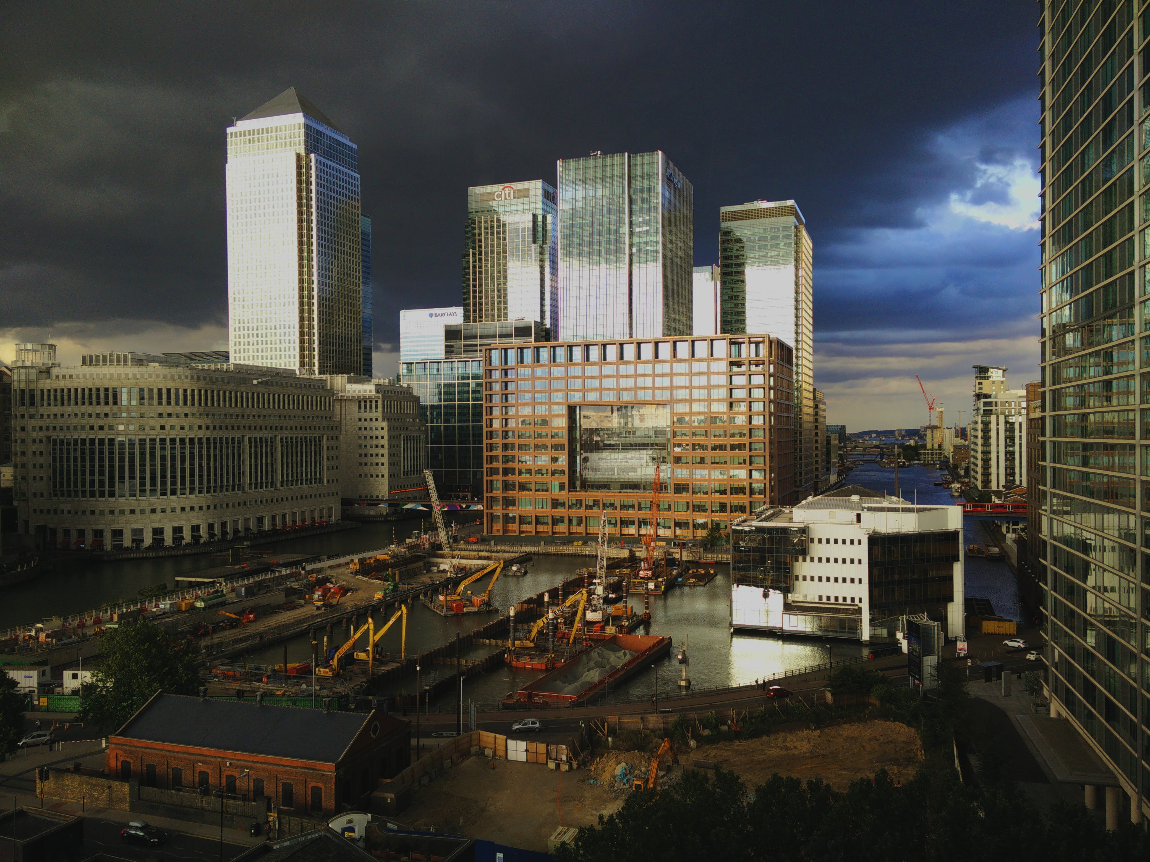

Text
Title Text (Calibri Light 34pt)
Standard text (Calibri standard 24pt)
Calibri Bold (Calibri Bold 24pt) (Only used for highlights en sub-headers)
Calibri Italic (Calibri Italic 24pt)
1st Secondary text (Calibri 20pt)
2nd Secondary text (Calibri 16pt)
Image credits (Calibri Light Italic 24pt) the color may be changed to improve visibility but should not draw attention.
Standard text color is not black but:
Background color is not WHITE but:
#33333 or R=42 G=42 B=42
#FFFFF or R=240 G=240 B=240
Colors
CHANGE IMAGE/PUT IMAGE
On the left you see the color pallette.
Try to use one “extra” color for a presentation or subject!
Colors used in this example presentation are just to show possibilities.
Some combinations will not work!!
When in doubt or if you want help, contact your course team e-learning developer or the NMC
1
If necessary, delete the existing image using the 'Delete' button. Click the icon to insert a new image. (see example below).
2
Select the desired image and click 'Insert'.
Title slide
Insert
Contact your course team e-learning developer or NMC for a custom title slide
3
To scale or crop the image, go to the 'Picture Tools - Format' tab and click the 'Crop' button. Scale the image the dots and the image frame with the c with corners.
Dr. John Doe
Basic colors
Extra colors
Crop
DO YOU NEED HELP?
Contact your course team e-learning developer or NewMedia Centre!
Photo credits: Pexels.com | foc foodoncam

Slide 12

Text
Title Text (Calibri Light 34pt)
Standard text (Calibri standard 24pt)
Calibri Bold (Calibri Bold 24pt) (Only used for highlights en sub-headers)
Calibri Italic (Calibri Italic 24pt)
1st Secondary text (Calibri 20pt)
2nd Secondary text (Calibri 16pt)
Image credits (Calibri Light Italic 24pt) the color may be changed to improve visibility but should not draw attention.
Standard text color is not black but:
Background color is not WHITE but:
#33333 or R=42 G=42 B=42
#FFFFF or R=240 G=240 B=240
Colors
CHANGE IMAGE/PUT IMAGE
On the left you see the color pallette.
Try to use one “extra” color for a presentation or subject!
Colors used in this example presentation are just to show possibilities.
Some combinations will not work!!
When in doubt or if you want help, contact your course team e-learning developer or the NMC
1
If necessary, delete the existing image using the 'Delete' button. Click the icon to insert a new image. (see example below).
2
Select the desired image and click 'Insert'.
Title slide
Insert
Contact your course team e-learning developer or NMC for a custom title slide
3
To scale or crop the image, go to the 'Picture Tools - Format' tab and click the 'Crop' button. Scale the image the dots and the image frame with the c with orners.
Basic colors
Extra colors
Dr. John Doe
Crop
DO YOU NEED HELP?
Contact your course team e-learning developer or NewMedia Centre!
Photo credits: Pexels.com | foc foodoncam

Slide 13
Text
Title Text (Calibri Light 34pt)
Standard text (Calibri standard 24pt)
Calibri Bold (Calibri Bold 24pt) (Only used for highlights en sub-headers)
Calibri Italic (Calibri Italic 24pt)
1st Secondary text (Calibri 20pt)
2nd Secondary text (Calibri 16pt)
Image credits (Calibri Light Italic 24pt) the color may be changed to improve visibility but should not draw attention.
Standard text color is not black but:
Background color is not WHITE but:
#33333 or R=42 G=42 B=42
#FFFFF or R=240 G=240 B=240
Colors
CHANGE IMAGE/PUT IMAGE
On the left you see the color pallette.
Try to use one “extra” color for a presentation or subject!
Colors used in this example presentation are just to show possibilities.
Some combinations will not work!!
When in doubt or if you want help, contact your course team e-learning developer or the NMC
1
If necessary, delete the existing image using the 'Delete' button. Click the icon to insert a new image. (see example below).
Title slide
2
Select the desired image and click 'Insert'.
Contact your course team e-learning developer or NMC for a custom title slide
Insert
3
To scale or crop the image, go to the 'Picture Tools - Format' tab and click the 'Crop' button. Scale the image the dots and the image frame with the c with corners.
Dr. John Doe
Basic colors
Extra colors
Crop
DO YOU NEED HELP?
Contact your course team e-learning developer or NewMedia Centre!
Photo credits: Pexels.com | foc foodoncam

Slide 14
Text
Title Text (Calibri Light 34pt)
Standard text (Calibri standard 24pt)
Calibri Bold (Calibri Bold 24pt) (Only used for highlights en sub-headers)
Calibri Italic (Calibri Italic 24pt)
1st Secondary text (Calibri 20pt)
2nd Secondary text (Calibri 16pt)
Image credits (Calibri Light Italic 24pt) the color may be changed to improve visibility but should not draw attention.
Standard text color is not black but:
Background color is not WHITE but:
Change colors (fiame)
1
Select the flame. Right-click and choose 'Fill'.
#33333 or R=42 G=42 B=42
2
Choose one of the theme colors or click on 'Eyedropper' and choose one of the colors shown here.
#FFFFF or R=240 G=240 B=240
Colors
CHANGE IMAGE/PUT IMAGE
On the left you see the color pallette.
Try to use one “extra” color for a presentation or subject!
Colors used in this example presentation are just to show possibilities.
Some combinations will not work!!
When in doubt or if you want help, contact your course team e-learning developer or the NMC
1
If necessary, delete the existing image using the 'Delete' button. Click the icon to insert a new image. (see example below).
2
Select the desired image and click 'Insert'.
Insert
Title slide
3
To scale or crop the image, go to the 'Picture Tools - Format' tab and click the 'Crop' button. Scale the image the dots and the image frame with the c with corners.
Contact your course team e-learning developer or NMC for a custom title slide
Basic colors
Extra colors
Dr. John Doe
Crop
DO YOU NEED HELP?
Contact your course team e-learning developer or NewMedia Centre!
Photo credits: Pexels.com | foc foodoncam

Slide 15
Text
Title Text (Calibri Light 34pt)
Standard text (Calibri standard 24pt)
Calibri Bold (Calibri Bold 24pt) (Only used for highlights en sub-headers)
Calibri Italic (Calibri Italic 24pt)
1st Secondary text (Calibri 20pt)
2nd Secondary text (Calibri 16pt)
Image credits (Calibri Light Italic 24pt) the color may be changed to improve visibility but should not draw attention.
Standard text color is not black but:
Background color is not WHITE but:
Change colors (fiame)
1
Select the flame. Right-click and choose 'Fill'.
#33333 or R=42 G=42 B=42
2
Choose one of the theme colors or click on 'Eyedropper' and choose one of the colors shown here.
#FFFFF or R=240 G=240 B=240
Colors
CHANGE IMAGE/PUT IMAGE
On the left you see the color pallette.
Try to use one “extra” color for a presentation or subject!
Colors used in this example presentation are just to show possibilities.
Some combinations will not work!!
When in doubt or if you want help, contact your course team e-learning developer or the NMC
1
If necessary, delete the existing image using the 'Delete' button. Click the icon to insert a new image. (see example below).
Title slide
2
Select the desired image and click 'Insert'.
Contact your course team e-learning developer or NMC for a custom title slide
Insert
3
To scale or crop the image, go to the 'Picture Tools - Format' tab and click the 'Crop' button. Scale the image the dots and the image frame with the c with corners.
Basic colors
Extra colors
Dr. John Doe
Crop
DO YOU NEED HELP?
Contact your course team e-learning developer or NewMedia Centre!
Photo credits: Pexels.com | foc foodoncam

Slide 16
Text
Title Text (Calibri Light 34pt)
Standard text (Calibri standard 24pt)
Calibri Bold (Calibri Bold 24pt) (Only used for highlights en sub-headers)
Calibri Italic (Calibri Italic 24pt)
1st Secondary text (Calibri 20pt)
2nd Secondary text (Calibri 16pt)
Image credits (Calibri Light Italic 24pt) the color may be changed to improve visibility but should not draw attention.
Standard text color is not black but:
Background color is not WHITE but:
Change colors (fiame)
1
Select the flame. Right-click and choose 'Fill'.
#33333 or R=42 G=42 B=42
2
Choose one of the theme colors or click on 'Eyedropper' and choose one of the colors shown here.
#FFFFF or R=240 G=240 B=240
Colors
CHANGE IMAGE/PUT IMAGE
On the left you see the color pallette.
Try to use one “extra” color for a presentation or subject!
Colors used in this example presentation are just to show possibilities.
Some combinations will not work!!
When in doubt or if you want help, contact your course team e-learning developer or the NMC
1
If necessary, delete the existing image using the 'Delete' button. Click the icon to insert a new image. (see example below).
2
Select the desired image and click 'Insert'.
Insert
Title slide
3
To scale or crop the image, go to the 'Picture Tools - Format' tab and click the 'Crop' button. Scale the image the dots and the image frame with the c with corners.
Contact your course team e-learning developer or NMC for a custom title slide
Basic colors
Extra colors
Dr. John Doe
Crop
DO YOU NEED HELP?
Contact your course team e-learning developer or NewMedia Centre!
Photo credits: Pexels.com | foc foodoncam

Slide 17
Text
Title Text (Calibri Light 34pt)
Standard text (Calibri standard 24pt)
Calibri Bold (Calibri Bold 24pt) (Only used for highlights en sub-headers)
Calibri Italic (Calibri Italic 24pt)
1st Secondary text (Calibri 20pt)
2nd Secondary text (Calibri 16pt)
Image credits (Calibri Light Italic 24pt) the color may be changed to improve visibility but should not draw attention.
Standard text color is not black but:
Background color is not WHITE but:
Change colors (fiame)
1
Select the flame. Right-click and choose 'Fill'.
#33333 or R=42 G=42 B=42
2
Choose one of the theme colors or click on 'Eyedropper' and choose one of the colors shown here.
#FFFFF or R=240 G=240 B=240
Colors
CHANGE IMAGE/PUT IMAGE
On the left you see the color pallette.
Try to use one “extra” color for a presentation or subject!
Colors used in this example presentation are just to show possibilities.
Some combinations will not work!!
When in doubt or if you want help, contact your course team e-learning developer or the NMC
1
If necessary, delete the existing image using the 'Delete' button. Click the icon to insert a new image. (see example below).
2
Select the desired image and click 'Insert'.
Insert
Title slide
3
To scale or crop the image, go to the 'Picture Tools - Format' tab and click the 'Crop' button. Scale the image the dots and the image frame with the c with corners.
Contact your course team e-learning developer or NMC for a custom title slide
Basic colors
Extra colors
Dr. John Doe
Crop
DO YOU NEED HELP?
Contact your course team e-learning developer or NewMedia Centre!
Photo credits: Pexels.com | foc foodoncam

Slide 18
Text
Title Text (Calibri Light 34pt)
Standard text (Calibri standard 24pt)
Calibri Bold (Calibri Bold 24pt) (Only used for highlights en sub-headers)
Calibri Italic (Calibri Italic 24pt)
1st Secondary text (Calibri 20pt)
2nd Secondary text (Calibri 16pt)
Image credits (Calibri Light Italic 24pt) the color may be changed to improve visibility but should not draw attention.
Standard text color is not black but:
Background color is not WHITE but:
Change colors (fiame)
1
Select the flame. Right-click and choose 'Fill'.
#33333 or R=42 G=42 B=42
2
Choose one of the theme colors or click on 'Eyedropper' and choose one of the colors shown here.
#FFFFF or R=240 G=240 B=240
Colors
CHANGE IMAGE/PUT IMAGE
On the left you see the color pallette.
Try to use one “extra” color for a presentation or subject!
Colors used in this example presentation are just to show possibilities.
Some combinations will not work!!
When in doubt or if you want help, contact your course team e-learning developer or the NMC
1
If necessary, delete the existing image using the 'Delete' button. Click the icon to insert a new image. (see example below).
2
Select the desired image and click 'Insert'.
Insert
Title slide
3
To scale or crop the image, go to the 'Picture Tools - Format' tab and click the 'Crop' button. Scale the image the dots and the image frame with the c with corners.
Contact your course team e-learning developer or NMC for a custom title slide
Basic colors
Extra colors
Dr. John Doe
Crop
DO YOU NEED HELP?
Contact your course team e-learning developer or NewMedia Centre!
Photo credits: Pexels.com | foc foodoncam

Slide 19
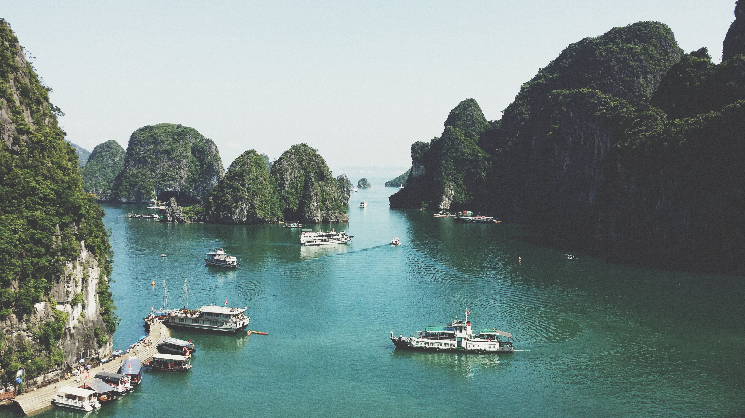
Text
Title Text (Calibri Light 34pt)
Standard text (Calibri standard 24pt)
Calibri Bold (Calibri Bold 24pt) (Only used for highlights en sub-headers)
Calibri Italic (Calibri Italic 24pt)
1st Secondary text (Calibri 20pt)
2nd Secondary text (Calibri 16pt)
Image credits (Calibri Light Italic 24pt) the color may be changed to improve visibility but should not draw attention.
Standard text color is not black but:
Background color is not WHITE but:
#33333 or R=42 G=42 B=42
#FFFFF or R=240 G=240 B=240
Colors
CHANGE IMAGE/PUT IMAGE
On the left you see the color pallette.
Try to use one “extra” color for a presentation or subject!
Colors used in this example presentation are just to show possibilities.
Some combinations will not work!!
When in doubt or if you want help, contact your course team e-learning developer or the NMC
1
If necessary, delete the existing image using the 'Delete' button. Click the icon to insert a new image. (see example below).
Title slide
Contact your course team e-learning developer or NMC for a custom title slide
Dr. John Doe
2
Select the desired image and click 'Insert'.
Insert
3
To scale or crop the image, go to the 'Picture Tools - Format' tab and click the 'Crop' button. Scale the image the dots and the image frame with the c with corners.
Basic colors
Extra colors
Crop
DO YOU NEED HELP?
Contact your course team e-learning developer or NewMedia Centre!
Photo credits: Pexels.com | foc foodoncam

Slide 20
Text
Title Text (Calibri Light 34pt)
Standard text (Calibri standard 24pt)
Calibri Bold (Calibri Bold 24pt) (Only used for highlights en sub-headers)
Calibri Italic (Calibri Italic 24pt)
1st Secondary text (Calibri 20pt)
2nd Secondary text (Calibri 16pt)
Image credits (Calibri Light Italic 24pt) the color may be changed to improve visibility but should not draw attention.
Standard text color is not black but:
Background color is not WHITE but:
#33333 or R=42 G=42 B=42
#FFFFF or R=240 G=240 B=240
Colors
CHANGE IMAGE/PUT IMAGE
On the left you see the color pallette.
Try to use one “extra” color for a presentation or subject!
Colors used in this example presentation are just to show possibilities.
Some combinations will not work!!
When in doubt or if you want help, contact your course team e-learning developer or the NMC
1
If necessary, delete the existing image using the 'Delete' button. Click the icon to insert a new image. (see example below).
2
Select the desired image and click 'Insert'.
Insert
3
To scale or crop the image, go to the 'Picture Tools - Format' tab and click the 'Crop' button. Scale the image the dots and the image frame with the c with corners.
Title slide
Basic colors
Extra colors
Contact your course team e-learning developer or NMC for a custom title slide
Crop
Dr. John Doe
DO YOU NEED HELP?
Contact your course team e-learning developer or NewMedia Centre!
Photo credits: Pexels.com | foc foodoncam

Slide 21
Text
Title Text (Calibri Light 34pt)
Standard text (Calibri standard 24pt)
Calibri Bold (Calibri Bold 24pt) (Only used for highlights en sub-headers)
Calibri Italic (Calibri Italic 24pt)
1st Secondary text (Calibri 20pt)
2nd Secondary text (Calibri 16pt)
Image credits (Calibri Light Italic 24pt) the color may be changed to improve visibility but should not draw attention.
Standard text color is not black but:
Background color is not WHITE but:
Change colors (fiame)
1
Select the flame. Right-click and choose 'Fill'.
#33333 or R=42 G=42 B=42
2
Choose one of the theme colors or click on 'Eyedropper' and choose one of the colors shown here.
#FFFFF or R=240 G=240 B=240
Colors
CHANGE IMAGE/PUT IMAGE
On the left you see the color pallette.
Try to use one “extra” color for a presentation or subject!
Colors used in this example presentation are just to show possibilities.
Some combinations will not work!!
When in doubt or if you want help, contact your course team e-learning developer or the NMC
1
If necessary, delete the existing image using the 'Delete' button. Click the icon to insert a new image. (see example below).
2
Select the desired image and click 'Insert'.
Title slide
Insert
3
To scale or crop the image, go to the 'Picture Tools - Format' tab and click the 'Crop' button. Scale the image the dots and the image frame with the c with corners.
Contact your course team e-learning developer or NMC for a custom title slide
Basic colors
Extra colors
Dr. John Doe
Crop
DO YOU NEED HELP?
Contact your course team e-learning developer or NewMedia Centre!

Slide 22
Text
Title Text (Calibri Light 34pt)
Standard text (Calibri standard 24pt)
Calibri Bold (Calibri Bold 24pt) (Only used for highlights en sub-headers)
Calibri Italic (Calibri Italic 24pt)
1st Secondary text (Calibri 20pt)
2nd Secondary text (Calibri 16pt)
Image credits (Calibri Light Italic 24pt) the color may be changed to improve visibility but should not draw attention.
Standard text color is not black but:
Background color is not WHITE but:
Change colors (fiame)
1
Select the flame. Right-click and choose 'Fill'.
#33333 or R=42 G=42 B=42
2
Choose one of the theme colors or click on 'Eyedropper' and choose one of the colors shown here.
#FFFFF or R=240 G=240 B=240
Colors
CHANGE IMAGE/PUT IMAGE
On the left you see the color pallette.
Try to use one “extra” color for a presentation or subject!
Colors used in this example presentation are just to show possibilities.
Some combinations will not work!!
When in doubt or if you want help, contact your course team e-learning developer or the NMC
1
If necessary, delete the existing image using the 'Delete' button. Click the icon to insert a new image. (see example below).
2
Select the desired image and click 'Insert'.
Title slide
Insert
3
To scale or crop the image, go to the 'Picture Tools - Format' tab and click the 'Crop' button. Scale the image the dots and the image frame with the c with corners.
Contact your course team e-learning developer or NMC for a custom title slide
Basic colors
Extra colors
Dr. John Doe
Crop
DO YOU NEED HELP?
Contact your course team e-learning developer or NewMedia Centre!

Slide 23
Text
Title Text (Calibri Light 34pt)
Standard text (Calibri standard 24pt)
Calibri Bold (Calibri Bold 24pt) (Only used for highlights en sub-headers)
Calibri Italic (Calibri Italic 24pt)
1st Secondary text (Calibri 20pt)
2nd Secondary text (Calibri 16pt)
Image credits (Calibri Light Italic 24pt) the color may be changed to improve visibility but should not draw attention.
Standard text color is not black but:
Background color is not WHITE but:
Change colors (fiame)
1
Select the flame. Right-click and choose 'Fill'.
#33333 or R=42 G=42 B=42
2
Choose one of the theme colors or click on 'Eyedropper' and choose one of the colors shown here.
#FFFFF or R=240 G=240 B=240
Colors
CHANGE IMAGE/PUT IMAGE
On the left you see the color pallette.
Try to use one “extra” color for a presentation or subject!
Colors used in this example presentation are just to show possibilities.
Some combinations will not work!!
When in doubt or if you want help, contact your course team e-learning developer or the NMC
1
If necessary, delete the existing image using the 'Delete' button. Click the icon to insert a new image. (see example below).
2
Select the desired image and click 'Insert'.
Title slide
Insert
3
To scale or crop the image, go to the 'Picture Tools - Format' tab and click the 'Crop' button. Scale the image the dots and the image frame with the c with corners.
Contact your course team e-learning developer or NMC for a custom title slide
Basic colors
Extra colors
Dr. John Doe
Crop
DO YOU NEED HELP?
Contact your course team e-learning developer or NewMedia Centre!

Slide 24
Text
Title Text (Calibri Light 34pt)
Standard text (Calibri standard 24pt)
Calibri Bold (Calibri Bold 24pt) (Only used for highlights en sub-headers)
Calibri Italic (Calibri Italic 24pt)
1st Secondary text (Calibri 20pt)
2nd Secondary text (Calibri 16pt)
Image credits (Calibri Light Italic 24pt) the color may be changed to improve visibility but should not draw attention.
Standard text color is not black but:
Background color is not WHITE but:
Change colors (fiame)
1
Select the flame. Right-click and choose 'Fill'.
#33333 or R=42 G=42 B=42
2
Choose one of the theme colors or click on 'Eyedropper' and choose one of the colors shown here.
#FFFFF or R=240 G=240 B=240
Colors
CHANGE IMAGE/PUT IMAGE
On the left you see the color pallette.
Try to use one “extra” color for a presentation or subject!
Colors used in this example presentation are just to show possibilities.
Some combinations will not work!!
When in doubt or if you want help, contact your course team e-learning developer or the NMC
1
If necessary, delete the existing image using the 'Delete' button. Click the icon to insert a new image. (see example below).
2
Select the desired image and click 'Insert'.
Title slide
Insert
3
To scale or crop the image, go to the 'Picture Tools - Format' tab and click the 'Crop' button. Scale the image the dots and the image frame with the c with corners.
Contact your course team
e-learning developer or NMC for a custom title slide
Basic colors
Extra colors
Dr. John Doe
Crop
DO YOU NEED HELP?
Contact your course team e-learning developer or NewMedia Centre!

Slide 25
Text
Title Text (Calibri Light 34pt)
Standard text (Calibri standard 24pt)
Calibri Bold (Calibri Bold 24pt) (Only used for highlights en sub-headers)
Calibri Italic (Calibri Italic 24pt)
1st Secondary text (Calibri 20pt)
2nd Secondary text (Calibri 16pt)
Image credits (Calibri Light Italic 24pt) the color may be changed to improve visibility but should not draw attention.
Standard text color is not black but:
Background color is not WHITE but:
#33333 or R=42 G=42 B=42
#FFFFF or R=240 G=240 B=240
Colors
CHANGE IMAGE/PUT IMAGE
On the left you see the color pallette.
Try to use one “extra” color for a presentation or subject!
Colors used in this example presentation are just to show possibilities.
Some combinations will not work!!
When in doubt or if you want help, contact your course team e-learning developer or the NMC
1
If necessary, delete the existing image using the 'Delete' button. Click the icon to insert a new image. (see example below).
“Put a quote here, let’s
write something interesting.”
2
Select the desired image and click 'Insert'.
Insert
3
To scale or crop the image, go to the 'Picture Tools - Format' tab and click the 'Crop' button. Scale the image the dots and the image frame with the c with corners.
Basic colors
Extra colors
Crop
DO YOU NEED HELP?
Contact your course team e-learning developer or NewMedia Centre!

Slide 26
Text
Title Text (Calibri Light 34pt)
Standard text (Calibri standard 24pt)
Calibri Bold (Calibri Bold 24pt) (Only used for highlights en sub-headers)
Calibri Italic (Calibri Italic 24pt)
1st Secondary text (Calibri 20pt)
2nd Secondary text (Calibri 16pt)
Image credits (Calibri Light Italic 24pt) the color may be changed to improve visibility but should not draw attention.
Standard text color is not black but:
Background color is not WHITE but:
#33333 or R=42 G=42 B=42
#FFFFF or R=240 G=240 B=240
Colors
CHANGE IMAGE/PUT IMAGE
On the left you see the color pallette.
Try to use one “extra” color for a presentation or subject!
Colors used in this example presentation are just to show possibilities.
Some combinations will not work!!
When in doubt or if you want help, contact your course team e-learning developer or the NMC
1
If necessary, delete the existing image using the 'Delete' button. Click the icon to insert a new image. (see example below).
2
Select the desired image and click 'Insert'.
Insert
3
To scale or crop the image, go to the 'Picture Tools - Format' tab and click the 'Crop' button. Scale the image the dots and the image frame with the c with corners.
Basic colors
Extra colors
Crop
Subject 1
Subject 2
Subject 3
Subject 4
Subject 5
DO YOU NEED HELP?
Contact your course team e-learning developer or NewMedia Centre!

Slide 27
Text
Title Text (Calibri Light 34pt)
Standard text (Calibri standard 24pt)
Calibri Bold (Calibri Bold 24pt) (Only used for highlights en sub-headers)
Calibri Italic (Calibri Italic 24pt)
1st Secondary text (Calibri 20pt)
2nd Secondary text (Calibri 16pt)
Image credits (Calibri Light Italic 24pt) the color may be changed to improve visibility but should not draw attention.
Standard text color is not black but:
Background color is not WHITE but:
#33333 or R=42 G=42 B=42
#FFFFF or R=240 G=240 B=240
Colors
CHANGE IMAGE/PUT IMAGE
On the left you see the color pallette.
Try to use one “extra” color for a presentation or subject!
Colors used in this example presentation are just to show possibilities.
Some combinations will not work!!
When in doubt or if you want help, contact your course team e-learning developer or the NMC
1
If necessary, delete the existing image using the 'Delete' button. Click the icon to insert a new image. (see example below).
100%
100%
80%
90%
70%
50%
60%
2
Select the desired image and click 'Insert'.
Insert
3
To scale or crop the image, go to the 'Picture Tools - Format' tab and click the 'Crop' button. Scale the image the dots and the image frame with the c with corners.
Basic colors
Extra colors
Crop
2000
2001
2002
2003
2004
2005
2006
DO YOU NEED HELP?
Contact your course team e-learning developer or NewMedia Centre!

Slide 28
Text
Title Text (Calibri Light 34pt)
Standard text (Calibri standard 24pt)
Calibri Bold (Calibri Bold 24pt) (Only used for highlights en sub-headers)
Calibri Italic (Calibri Italic 24pt)
1st Secondary text (Calibri 20pt)
2nd Secondary text (Calibri 16pt)
Image credits (Calibri Light Italic 24pt) the color may be changed to improve visibility but should not draw attention.
Standard text color is not black but:
Background color is not WHITE but:
#33333 or R=42 G=42 B=42
#FFFFF or R=240 G=240 B=240
Colors
CHANGE IMAGE/PUT IMAGE
Write a title
On the left you see the color pallette.
Try to use one “extra” color for a presentation or subject!
Colors used in this example presentation are just to show possibilities.
Some combinations will not work!!
When in doubt or if you want help, contact your course team e-learning developer or the NMC
1
If necessary, delete the existing image using the 'Delete' button. Click the icon to insert a new image. (see example below).
2
Select the desired image and click 'Insert'.
Insert
3
To scale or crop the image, go to the 'Picture Tools - Format' tab and click the 'Crop' button. Scale the image the dots and the image frame with the c with corners.
Basic colors
Extra colors
Crop
DO YOU NEED HELP?
Contact your course team e-learning developer or NewMedia Centre!

Slide 29
Text
Title Text (Calibri Light 34pt)
Standard text (Calibri standard 24pt)
Calibri Bold (Calibri Bold 24pt) (Only used for highlights en sub-headers)
Calibri Italic (Calibri Italic 24pt)
1st Secondary text (Calibri 20pt)
2nd Secondary text (Calibri 16pt)
Image credits (Calibri Light Italic 24pt) the color may be changed to improve visibility but should not draw attention.
Standard text color is not black but:
Background color is not WHITE but:
#33333 or R=42 G=42 B=42
#FFFFF or R=240 G=240 B=240
Colors
CHANGE IMAGE/PUT IMAGE
On the left you see the color pallette.
Try to use one “extra” color for a presentation or subject!
Colors used in this example presentation are just to show possibilities.
Some combinations will not work!!
When in doubt or if you want help, contact your course team e-learning developer or the NMC
1
If necessary, delete the existing image using the 'Delete' button. Click the icon to insert a new image. (see example below).
2
Select the desired image and click 'Insert'.
Insert
3
To scale or crop the image, go to the 'Picture Tools - Format' tab and click the 'Crop' button. Scale the image the dots and the image frame with the c with corners.
Basic colors
Extra colors
Crop
DO YOU NEED HELP?
Contact your course team e-learning developer or NewMedia Centre!

Slide 30
Text
Title Text (Calibri Light 34pt)
Standard text (Calibri standard 24pt)
Calibri Bold (Calibri Bold 24pt) (Only used for highlights en sub-headers)
Calibri Italic (Calibri Italic 24pt)
1st Secondary text (Calibri 20pt)
2nd Secondary text (Calibri 16pt)
Image credits (Calibri Light Italic 24pt) the color may be changed to improve visibility but should not draw attention.
Standard text color is not black but:
Background color is not WHITE but:
#33333 or R=42 G=42 B=42
#FFFFF or R=240 G=240 B=240
Colors
CHANGE IMAGE/PUT IMAGE
On the left you see the color pallette.
Try to use one “extra” color for a presentation or subject!
Colors used in this example presentation are just to show possibilities.
Some combinations will not work!!
When in doubt or if you want help, contact your course team e-learning developer or the NMC
1
If necessary, delete the existing image using the 'Delete' button. Click the icon to insert a new image. (see example below).
Pie chart
Pie chart
Pie chart
2
Select the desired image and click 'Insert'.
Insert
3
To scale or crop the image, go to the 'Picture Tools - Format' tab and click the 'Crop' button. Scale the image the dots and the image frame with the c with corners.
Basic colors
Extra colors
Crop
DO YOU NEED HELP?
Contact your course team e-learning developer or NewMedia Centre!

Slide 31
Text
Title Text (Calibri Light 34pt)
Standard text (Calibri standard 24pt)
Calibri Bold (Calibri Bold 24pt) (Only used for highlights en sub-headers)
Calibri Italic (Calibri Italic 24pt)
1st Secondary text (Calibri 20pt)
2nd Secondary text (Calibri 16pt)
Image credits (Calibri Light Italic 24pt) the color may be changed to improve visibility but should not draw attention.
Standard text color is not black but:
Background color is not WHITE but:
#33333 or R=42 G=42 B=42
#FFFFF or R=240 G=240 B=240
Colors
CHANGE IMAGE/PUT IMAGE
On the left you see the color pallette.
Try to use one “extra” color for a presentation or subject!
Colors used in this example presentation are just to show possibilities.
Some combinations will not work!!
When in doubt or if you want help, contact your course team e-learning developer or the NMC
1
If necessary, delete the existing image using the 'Delete' button. Click the icon to insert a new image. (see example below).
2
Select the desired image and click 'Insert'.
Insert
3
To scale or crop the image, go to the 'Picture Tools - Format' tab and click the 'Crop' button. Scale the image the dots and the image frame with the c with corners.
Basic colors
Extra colors
Crop
This vs that
DO YOU NEED HELP?
Contact your course team e-learning developer or NewMedia Centre!

Slide 32
Text
Title Text (Calibri Light 34pt)
Standard text (Calibri standard 24pt)
Calibri Bold (Calibri Bold 24pt) (Only used for highlights en sub-headers)
Calibri Italic (Calibri Italic 24pt)
1st Secondary text (Calibri 20pt)
2nd Secondary text (Calibri 16pt)
Image credits (Calibri Light Italic 24pt) the color may be changed to improve visibility but should not draw attention.
Standard text color is not black but:
Background color is not WHITE but:
#33333 or R=42 G=42 B=42
#FFFFF or R=240 G=240 B=240
Colors
CHANGE IMAGE/PUT IMAGE
On the left you see the color pallette.
Try to use one “extra” color for a presentation or subject!
Colors used in this example presentation are just to show possibilities.
Some combinations will not work!!
When in doubt or if you want help, contact your course team e-learning developer or the NMC
1
If necessary, delete the existing image using the 'Delete' button. Click the icon to insert a new image. (see example below).
2
Select the desired image and click 'Insert'.
Insert
3
To scale or crop the image, go to the 'Picture Tools - Format' tab and click the 'Crop' button. Scale the image the dots and the image frame with the c with corners.
pitch
volume
timbre
frequency
amplitude
??
Basic colors
Extra colors
Crop
DO YOU NEED HELP?
Contact your course team e-learning developer or NewMedia Centre!

Slide 33
Text
Title Text (Calibri Light 34pt)
Standard text (Calibri standard 24pt)
Calibri Bold (Calibri Bold 24pt) (Only used for highlights en sub-headers)
Calibri Italic (Calibri Italic 24pt)
1st Secondary text (Calibri 20pt)
2nd Secondary text (Calibri 16pt)
Image credits (Calibri Light Italic 24pt) the color may be changed to improve visibility but should not draw attention.
Standard text color is not black but:
Background color is not WHITE but:
#33333 or R=42 G=42 B=42
#FFFFF or R=240 G=240 B=240
Colors
CHANGE IMAGE/PUT IMAGE
On the left you see the color pallette.
Try to use one “extra” color for a presentation or subject!
Colors used in this example presentation are just to show possibilities.
Some combinations will not work!!
When in doubt or if you want help, contact your course team e-learning developer or the NMC
1
If necessary, delete the existing image using the 'Delete' button. Click the icon to insert a new image. (see example below).
This is a subject slide
2
Select the desired image and click 'Insert'.
Insert
3
To scale or crop the image, go to the 'Picture Tools - Format' tab and click the 'Crop' button. Scale the image the dots and the image frame with the c with corners.
Basic colors
Extra colors
Crop
DO YOU NEED HELP?
Contact your course team e-learning developer or NewMedia Centre!

Slide 34
Text
Title Text (Calibri Light 34pt)
Standard text (Calibri standard 24pt)
Calibri Bold (Calibri Bold 24pt) (Only used for highlights en sub-headers)
Calibri Italic (Calibri Italic 24pt)
1st Secondary text (Calibri 20pt)
2nd Secondary text (Calibri 16pt)
Image credits (Calibri Light Italic 24pt) the color may be changed to improve visibility but should not draw attention.
Standard text color is not black but:
Background color is not WHITE but:
#33333 or R=42 G=42 B=42
#FFFFF or R=240 G=240 B=240
Colors
CHANGE IMAGE/PUT IMAGE
On the left you see the color pallette.
Try to use one “extra” color for a presentation or subject!
Colors used in this example presentation are just to show possibilities.
Some combinations will not work!!
When in doubt or if you want help, contact your course team e-learning developer or the NMC
1
If necessary, delete the existing image using the 'Delete' button. Click the icon to insert a new image. (see example below).
This is a subject slide with a number
2
Select the desired image and click 'Insert'.
Insert
3
To scale or crop the image, go to the 'Picture Tools - Format' tab and click the 'Crop' button. Scale the image the dots and the image frame with the c with corners.
Basic colors
Extra colors
Crop
DO YOU NEED HELP?
Contact your course team e-learning developer or NewMedia Centre!

Slide 35
Text
Title Text (Calibri Light 34pt)
Standard text (Calibri standard 24pt)
Calibri Bold (Calibri Bold 24pt) (Only used for highlights en sub-headers)
Calibri Italic (Calibri Italic 24pt)
1st Secondary text (Calibri 20pt)
2nd Secondary text (Calibri 16pt)
Image credits (Calibri Light Italic 24pt) the color may be changed to improve visibility but should not draw attention.
Standard text color is not black but:
Background color is not WHITE but:
#33333 or R=42 G=42 B=42
#FFFFF or R=240 G=240 B=240
Colors
CHANGE IMAGE/PUT IMAGE
On the left you see the color pallette.
Try to use one “extra” color for a presentation or subject!
Colors used in this example presentation are just to show possibilities.
Some combinations will not work!!
When in doubt or if you want help, contact your course team e-learning developer or the NMC
1
If necessary, delete the existing image using the 'Delete' button. Click the icon to insert a new image. (see example below).
This is a subject slide with a number
2
Select the desired image and click 'Insert'.
Insert
3
To scale or crop the image, go to the 'Picture Tools - Format' tab and click the 'Crop' button. Scale the image the dots and the image frame with the c with corners.
Basic colors
Extra colors
Crop
DO YOU NEED HELP?
Contact your course team e-learning developer or NewMedia Centre!

Slide 36
Text
Title Text (Calibri Light 34pt)
Standard text (Calibri standard 24pt)
Calibri Bold (Calibri Bold 24pt) (Only used for highlights en sub-headers)
Calibri Italic (Calibri Italic 24pt)
1st Secondary text (Calibri 20pt)
2nd Secondary text (Calibri 16pt)
Image credits (Calibri Light Italic 24pt) the color may be changed to improve visibility but should not draw attention.
Standard text color is not black but:
Background color is not WHITE but:
Change colors (fiame)
1
Select the flame. Right-click and choose 'Fill'.
#33333 or R=42 G=42 B=42
2
Choose one of the theme colors or click on 'Eyedropper' and choose one of the colors shown here.
#FFFFF or R=240 G=240 B=240
Colors
CHANGE IMAGE/PUT IMAGE
On the left you see the color pallette.
Try to use one “extra” color for a presentation or subject!
Colors used in this example presentation are just to show possibilities.
Some combinations will not work!!
When in doubt or if you want help, contact your course team e-learning developer or the NMC
1
If necessary, delete the existing image using the 'Delete' button. Click the icon to insert a new image. (see example below).
This is a subject slide with a number
2
Select the desired image and click 'Insert'.
Insert
3
To scale or crop the image, go to the 'Picture Tools - Format' tab and click the 'Crop' button. Scale the image the dots and the image frame with the c with corners.
Basic colors
Extra colors
Crop
DO YOU NEED HELP?
Contact your course team e-learning developer or NewMedia Centre!

Slide 37
Text
Title Text (Calibri Light 34pt)
Standard text (Calibri standard 24pt)
Calibri Bold (Calibri Bold 24pt) (Only used for highlights en sub-headers)
Calibri Italic (Calibri Italic 24pt)
1st Secondary text (Calibri 20pt)
2nd Secondary text (Calibri 16pt)
Image credits (Calibri Light Italic 24pt) the color may be changed to improve visibility but should not draw attention.
Standard text color is not black but:
Background color is not WHITE but:
Change colors (fiame)
1
Select the flame. Right-click and choose 'Fill'.
#33333 or R=42 G=42 B=42
2
Choose one of the theme colors or click on 'Eyedropper' and choose one of the colors shown here.
#FFFFF or R=240 G=240 B=240
Colors
CHANGE IMAGE/PUT IMAGE
On the left you see the color pallette.
Try to use one “extra” color for a presentation or subject!
Colors used in this example presentation are just to show possibilities.
Some combinations will not work!!
When in doubt or if you want help, contact your course team e-learning developer or the NMC
1
If necessary, delete the existing image using the 'Delete' button. Click the icon to insert a new image. (see example below).
This is a subject slide with a number
2
Select the desired image and click 'Insert'.
Insert
3
To scale or crop the image, go to the 'Picture Tools - Format' tab and click the 'Crop' button. Scale the image the dots and the image frame with the c with corners.
Basic colors
Extra colors
Crop
DO YOU NEED HELP?
Contact your course team e-learning developer or NewMedia Centre!

Slide 38
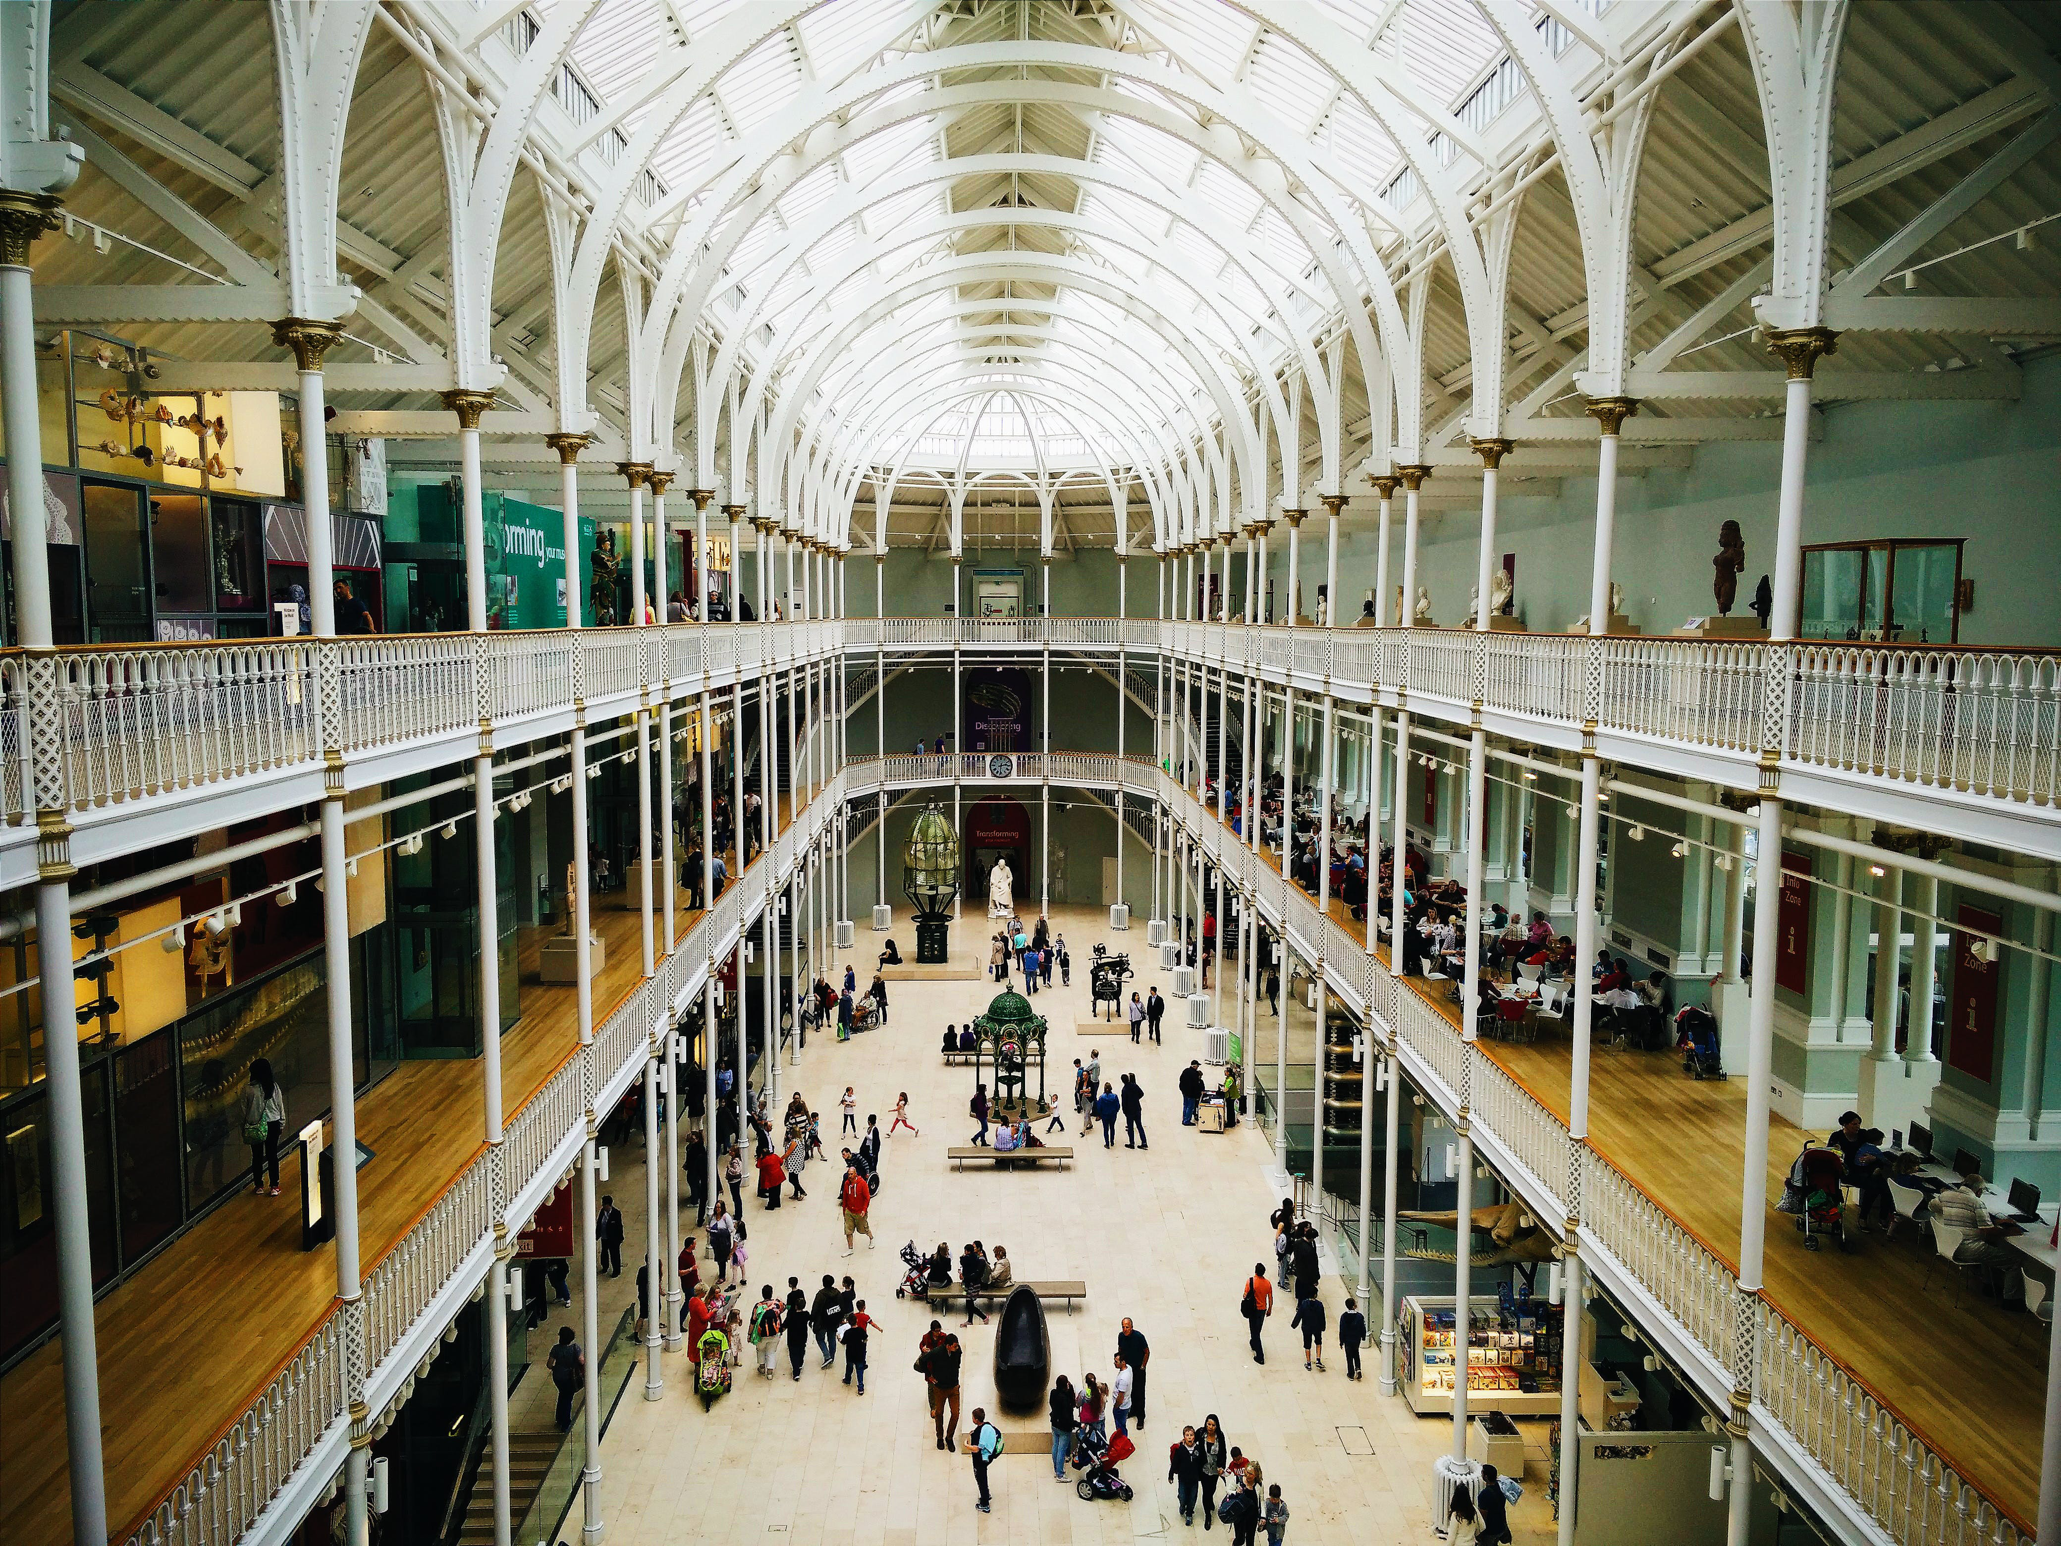
Text
Title Text (Calibri Light 34pt)
Standard text (Calibri standard 24pt)
Calibri Bold (Calibri Bold 24pt) (Only used for highlights en sub-headers)
Calibri Italic (Calibri Italic 24pt)
1st Secondary text (Calibri 20pt)
2nd Secondary text (Calibri 16pt)
Image credits (Calibri Light Italic 24pt) the color may be changed to improve visibility but should not draw attention.
Standard text color is not black but:
Background color is not WHITE but:
#33333 or R=42 G=42 B=42
#FFFFF or R=240 G=240 B=240
Colors
CHANGE IMAGE/PUT IMAGE
On the left you see the color pallette.
Try to use one “extra” color for a presentation or subject!
Colors used in this example presentation are just to show possibilities.
Some combinations will not work!!
When in doubt or if you want help, contact your course team e-learning developer or the NMC
1
If necessary, delete the existing image using the 'Delete' button. Click the icon to insert a new image. (see example below).
This is a subject slide
2
Select the desired image and click 'Insert'.
Insert
3
To scale or crop the image, go to the 'Picture Tools - Format' tab and click the 'Crop' button. Scale the image the dots and the image frame with the c with corners.
Basic colors
Extra colors
Crop
DO YOU NEED HELP?
Contact your course team e-learning developer or NewMedia Centre!

Slide 39
Text
Title Text (Calibri Light 34pt)
Standard text (Calibri standard 24pt)
Calibri Bold (Calibri Bold 24pt) (Only used for highlights en sub-headers)
Calibri Italic (Calibri Italic 24pt)
1st Secondary text (Calibri 20pt)
2nd Secondary text (Calibri 16pt)
Image credits (Calibri Light Italic 24pt) the color may be changed to improve visibility but should not draw attention.
Standard text color is not black but:
Background color is not WHITE but:
#33333 or R=42 G=42 B=42
#FFFFF or R=240 G=240 B=240
Colors
CHANGE IMAGE/PUT IMAGE
On the left you see the color pallette.
Try to use one “extra” color for a presentation or subject!
Colors used in this example presentation are just to show possibilities.
Some combinations will not work!!
When in doubt or if you want help, contact your course team e-learning developer or the NMC
1
If necessary, delete the existing image using the 'Delete' button. Click the icon to insert a new image. (see example below).
2
Select the desired image and click 'Insert'.
Insert
3
To scale or crop the image, go to the 'Picture Tools - Format' tab and click the 'Crop' button. Scale the image the dots and the image frame with the c with corners.
This is a subject slide
Basic colors
Extra colors
Crop
DO YOU NEED HELP?
Contact your course team e-learning developer or NewMedia Centre!

Slide 40
Text
Title Text (Calibri Light 34pt)
Standard text (Calibri standard 24pt)
Calibri Bold (Calibri Bold 24pt) (Only used for highlights en sub-headers)
Calibri Italic (Calibri Italic 24pt)
1st Secondary text (Calibri 20pt)
2nd Secondary text (Calibri 16pt)
Image credits (Calibri Light Italic 24pt) the color may be changed to improve visibility but should not draw attention.
Standard text color is not black but:
Background color is not WHITE but:
#33333 or R=42 G=42 B=42
#FFFFF or R=240 G=240 B=240
Colors
CHANGE IMAGE/PUT IMAGE
On the left you see the color pallette.
Try to use one “extra” color for a presentation or subject!
Colors used in this example presentation are just to show possibilities.
Some combinations will not work!!
When in doubt or if you want help, contact your course team e-learning developer or the NMC
1
If necessary, delete the existing image using the 'Delete' button. Click the icon to insert a new image. (see example below).
Formulas
2
Select the desired image and click 'Insert'.
Insert
3
To scale or crop the image, go to the 'Picture Tools - Format' tab and click the 'Crop' button. Scale the image the dots and the image frame with the c with corners.
Basic colors
Extra colors
Crop
DO YOU NEED HELP?
Contact your course team e-learning developer or NewMedia Centre!

Slide 41
Text
Title Text (Calibri Light 34pt)
Standard text (Calibri standard 24pt)
Calibri Bold (Calibri Bold 24pt) (Only used for highlights en sub-headers)
Calibri Italic (Calibri Italic 24pt)
1st Secondary text (Calibri 20pt)
2nd Secondary text (Calibri 16pt)
Image credits (Calibri Light Italic 24pt) the color may be changed to improve visibility but should not draw attention.
Standard text color is not black but:
Background color is not WHITE but:
#33333 or R=42 G=42 B=42
#FFFFF or R=240 G=240 B=240
Colors
CHANGE IMAGE/PUT IMAGE
On the left you see the color pallette.
Try to use one “extra” color for a presentation or subject!
Colors used in this example presentation are just to show possibilities.
Some combinations will not work!!
When in doubt or if you want help, contact your course team e-learning developer or the NMC
Example page for display of a formula
1
If necessary, delete the existing image using the 'Delete' button. Click the icon to insert a new image. (see example below).
If content = formula1: box = grey + tekst = black box = grey + tekst = not blue box = grey + tekst = not yellow box = grey + tekst = not green
If there is a formula:
PS: If programmes like latex or specific fonts are used it’s advised to create transparent images and place those in your powerpoint to avoid errors!
2
Select the desired image and click 'Insert'.
Insert
3
To scale or crop the image, go to the 'Picture Tools - Format' tab and click the 'Crop' button. Scale the image the dots and the image frame with the c with corners.
Basic colors
Extra colors
Crop
DO YOU NEED HELP?
Contact your course team e-learning developer or NewMedia Centre!

Slide 42
Text
Title Text (Calibri Light 34pt)
Standard text (Calibri standard 24pt)
Calibri Bold (Calibri Bold 24pt) (Only used for highlights en sub-headers)
Calibri Italic (Calibri Italic 24pt)
1st Secondary text (Calibri 20pt)
2nd Secondary text (Calibri 16pt)
Image credits (Calibri Light Italic 24pt) the color may be changed to improve visibility but should not draw attention.
Standard text color is not black but:
Background color is not WHITE but:
#33333 or R=42 G=42 B=42
#FFFFF or R=240 G=240 B=240
Colors
CHANGE IMAGE/PUT IMAGE
On the left you see the color pallette.
Try to use one “extra” color for a presentation or subject!
Colors used in this example presentation are just to show possibilities.
Some combinations will not work!!
When in doubt or if you want help, contact your course team e-learning developer or the NMC
Example page for display of a formula
1
If necessary, delete the existing image using the 'Delete' button. Click the icon to insert a new image. (see example below).
If there is a formula:
PS: If programmes like latex or specific fonts are used it’s advised to create transparent images and place those in your powerpoint to avoid errors!
If content = formula1: box = grey + tekst = black box = grey + tekst = not blue box = grey + tekst = not yellow box = grey + tekst = not green
2
Select the desired image and click 'Insert'.
Insert
3
To scale or crop the image, go to the 'Picture Tools - Format' tab and click the 'Crop' button. Scale the image the dots and the image frame with the c with corners.
Basic colors
Extra colors
Crop
DO YOU NEED HELP?
Contact your course team e-learning developer or NewMedia Centre!

Slide 43
Text
Title Text (Calibri Light 34pt)
Standard text (Calibri standard 24pt)
Calibri Bold (Calibri Bold 24pt) (Only used for highlights en sub-headers)
Calibri Italic (Calibri Italic 24pt)
1st Secondary text (Calibri 20pt)
2nd Secondary text (Calibri 16pt)
Image credits (Calibri Light Italic 24pt) the color may be changed to improve visibility but should not draw attention.
Standard text color is not black but:
Background color is not WHITE but:
#33333 or R=42 G=42 B=42
#FFFFF or R=240 G=240 B=240
Colors
CHANGE IMAGE/PUT IMAGE
On the left you see the color pallette.
Try to use one “extra” color for a presentation or subject!
Colors used in this example presentation are just to show possibilities.
Some combinations will not work!!
When in doubt or if you want help, contact your course team e-learning developer or the NMC
Example page for display of a formula
1
If necessary, delete the existing image using the 'Delete' button. Click the icon to insert a new image. (see example below).
If there is a formula:
PS: If programmes like latex or specific fonts are used it’s advised to create transparent images and place those in your powerpoint to avoid errors!
2
Select the desired image and click 'Insert'.
Insert
3
To scale or crop the image, go to the 'Picture Tools - Format' tab and click the 'Crop' button. Scale the image the dots and the image frame with the c with corners.
If content = formula1: box = grey + tekst = black box = grey + tekst = not blue box = grey + tekst = not yellow box = grey + tekst = not green
Basic colors
Extra colors
Crop
DO YOU NEED HELP?
Contact your course team e-learning developer or NewMedia Centre!

Slide 44
Text
Title Text (Calibri Light 34pt)
Standard text (Calibri standard 24pt)
Calibri Bold (Calibri Bold 24pt) (Only used for highlights en sub-headers)
Calibri Italic (Calibri Italic 24pt)
1st Secondary text (Calibri 20pt)
2nd Secondary text (Calibri 16pt)
Image credits (Calibri Light Italic 24pt) the color may be changed to improve visibility but should not draw attention.
Standard text color is not black but:
Background color is not WHITE but:
#33333 or R=42 G=42 B=42
#FFFFF or R=240 G=240 B=240
Colors
CHANGE IMAGE/PUT IMAGE
On the left you see the color pallette.
Try to use one “extra” color for a presentation or subject!
Colors used in this example presentation are just to show possibilities.
Some combinations will not work!!
When in doubt or if you want help, contact your course team e-learning developer or the NMC
1
If necessary, delete the existing image using the 'Delete' button. Click the icon to insert a new image. (see example below).
This is an example page for a definition
2
Select the desired image and click 'Insert'.
Insert
3
To scale or crop the image, go to the 'Picture Tools - Format' tab and click the 'Crop' button. Scale the image the dots and the image frame with the c with corners.
Basic colors
Extra colors
Crop
DO YOU NEED HELP?
Contact your course team e-learning developer or NewMedia Centre!

Slide 45
Text
Title Text (Calibri Light 34pt)
Standard text (Calibri standard 24pt)
Calibri Bold (Calibri Bold 24pt) (Only used for highlights en sub-headers)
Calibri Italic (Calibri Italic 24pt)
1st Secondary text (Calibri 20pt)
2nd Secondary text (Calibri 16pt)
Image credits (Calibri Light Italic 24pt) the color may be changed to improve visibility but should not draw attention.
Standard text color is not black but:
Background color is not WHITE but:
#33333 or R=42 G=42 B=42
#FFFFF or R=240 G=240 B=240
Colors
CHANGE IMAGE/PUT IMAGE
On the left you see the color pallette.
Try to use one “extra” color for a presentation or subject!
Colors used in this example presentation are just to show possibilities.
Some combinations will not work!!
When in doubt or if you want help, contact your course team e-learning developer or the NMC
1
If necessary, delete the existing image using the 'Delete' button. Click the icon to insert a new image. (see example below).
Example page
2
Select the desired image and click 'Insert'.
This is your definition
Insert
3
To scale or crop the image, go to the 'Picture Tools - Format' tab and click the 'Crop' button. Scale the image the dots and the image frame with the c with corners.
Basic colors
Extra colors
Crop
DO YOU NEED HELP?
Contact your course team e-learning developer or NewMedia Centre!
Photo credits: Pexels.com | foc foodoncam

Slide 46
Text
Title Text (Calibri Light 34pt)
Standard text (Calibri standard 24pt)
Calibri Bold (Calibri Bold 24pt) (Only used for highlights en sub-headers)
Calibri Italic (Calibri Italic 24pt)
1st Secondary text (Calibri 20pt)
2nd Secondary text (Calibri 16pt)
Image credits (Calibri Light Italic 24pt) the color may be changed to improve visibility but should not draw attention.
Standard text color is not black but:
Background color is not WHITE but:
#33333 or R=42 G=42 B=42
#FFFFF or R=240 G=240 B=240
Colors
CHANGE IMAGE/PUT IMAGE
On the left you see the color pallette.
Try to use one “extra” color for a presentation or subject!
Colors used in this example presentation are just to show possibilities.
Some combinations will not work!!
When in doubt or if you want help, contact your course team e-learning developer or the NMC
1
If necessary, delete the existing image using the 'Delete' button. Click the icon to insert a new image. (see example below).
Example page
2
Select the desired image and click 'Insert'.
This is your definition
Insert
3
To scale or crop the image, go to the 'Picture Tools - Format' tab and click the 'Crop' button. Scale the image the dots and the image frame with the c with corners.
Basic colors
Extra colors
Crop
DO YOU NEED HELP?
Contact your course team e-learning developer or NewMedia Centre!
Photo credits: Pexels.com | foc foodoncam

Slide 47
Text
Title Text (Calibri Light 34pt)
Standard text (Calibri standard 24pt)
Calibri Bold (Calibri Bold 24pt) (Only used for highlights en sub-headers)
Calibri Italic (Calibri Italic 24pt)
1st Secondary text (Calibri 20pt)
2nd Secondary text (Calibri 16pt)
Image credits (Calibri Light Italic 24pt) the color may be changed to improve visibility but should not draw attention.
Standard text color is not black but:
Background color is not WHITE but:
#33333 or R=42 G=42 B=42
#FFFFF or R=240 G=240 B=240
Colors
CHANGE IMAGE/PUT IMAGE
On the left you see the color pallette.
Try to use one “extra” color for a presentation or subject!
Colors used in this example presentation are just to show possibilities.
Some combinations will not work!!
When in doubt or if you want help, contact your course team e-learning developer or the NMC
1
If necessary, delete the existing image using the 'Delete' button. Click the icon to insert a new image. (see example below).
Definitions
2
Select the desired image and click 'Insert'.
Insert
3
To scale or crop the image, go to the 'Picture Tools - Format' tab and click the 'Crop' button. Scale the image the dots and the image frame with the c with corners.
Basic colors
Extra colors
Crop
DO YOU NEED HELP?
Contact your course team e-learning developer or NewMedia Centre!

Slide 48
Text
Title Text (Calibri Light 34pt)
Standard text (Calibri standard 24pt)
Calibri Bold (Calibri Bold 24pt) (Only used for highlights en sub-headers)
Calibri Italic (Calibri Italic 24pt)
1st Secondary text (Calibri 20pt)
2nd Secondary text (Calibri 16pt)
Image credits (Calibri Light Italic 24pt) the color may be changed to improve visibility but should not draw attention.
Standard text color is not black but:
Background color is not WHITE but:
#33333 or R=42 G=42 B=42
#FFFFF or R=240 G=240 B=240
Colors
CHANGE IMAGE/PUT IMAGE
On the left you see the color pallette.
Try to use one “extra” color for a presentation or subject!
Colors used in this example presentation are just to show possibilities.
Some combinations will not work!!
When in doubt or if you want help, contact your course team e-learning developer or the NMC
1
If necessary, delete the existing image using the 'Delete' button. Click the icon to insert a new image. (see example below).
This is an example page for a definition
2
Select the desired image and click 'Insert'.
Insert
3
To scale or crop the image, go to the 'Picture Tools - Format' tab and click the 'Crop' button. Scale the image the dots and the image frame with the c with corners.
Basic colors
Extra colors
Crop
DO YOU NEED HELP?
Contact your course team e-learning developer or NewMedia Centre!

Slide 49
Text
Title Text (Calibri Light 34pt)
Standard text (Calibri standard 24pt)
Calibri Bold (Calibri Bold 24pt) (Only used for highlights en sub-headers)
Calibri Italic (Calibri Italic 24pt)
1st Secondary text (Calibri 20pt)
2nd Secondary text (Calibri 16pt)
Image credits (Calibri Light Italic 24pt) the color may be changed to improve visibility but should not draw attention.
Standard text color is not black but:
Background color is not WHITE but:
#33333 or R=42 G=42 B=42
#FFFFF or R=240 G=240 B=240
Colors
CHANGE IMAGE/PUT IMAGE
On the left you see the color pallette.
Try to use one “extra” color for a presentation or subject!
Colors used in this example presentation are just to show possibilities.
Some combinations will not work!!
When in doubt or if you want help, contact your course team e-learning developer or the NMC
1
If necessary, delete the existing image using the 'Delete' button. Click the icon to insert a new image. (see example below).
This is an example page for a definition
2
Select the desired image and click 'Insert'.
Insert
3
To scale or crop the image, go to the 'Picture Tools - Format' tab and click the 'Crop' button. Scale the image the dots and the image frame with the c with corners.
Basic colors
Extra colors
Crop
DO YOU NEED HELP?
Contact your course team e-learning developer or NewMedia Centre!

Slide 50
Text
Title Text (Calibri Light 34pt)
Standard text (Calibri standard 24pt)
Calibri Bold (Calibri Bold 24pt) (Only used for highlights en sub-headers)
Calibri Italic (Calibri Italic 24pt)
1st Secondary text (Calibri 20pt)
2nd Secondary text (Calibri 16pt)
Image credits (Calibri Light Italic 24pt) the color may be changed to improve visibility but should not draw attention.
Standard text color is not black but:
Background color is not WHITE but:
#33333 or R=42 G=42 B=42
#FFFFF or R=240 G=240 B=240
Colors
CHANGE IMAGE/PUT IMAGE
On the left you see the color pallette.
Try to use one “extra” color for a presentation or subject!
Colors used in this example presentation are just to show possibilities.
Some combinations will not work!!
When in doubt or if you want help, contact your course team e-learning developer or the NMC
1
If necessary, delete the existing image using the 'Delete' button. Click the icon to insert a new image. (see example below).
the act of defining, or of making something definite, distinct, or clear
2
Select the desired image and click 'Insert'.
Insert
3
To scale or crop the image, go to the 'Picture Tools - Format' tab and click the 'Crop' button. Scale the image the dots and the image frame with the c with corners.
Basic colors
Extra colors
Crop
DO YOU NEED HELP?
Contact your course team e-learning developer or NewMedia Centre!

Slide 51
Text
Title Text (Calibri Light 34pt)
Standard text (Calibri standard 24pt)
Calibri Bold (Calibri Bold 24pt) (Only used for highlights en sub-headers)
Calibri Italic (Calibri Italic 24pt)
1st Secondary text (Calibri 20pt)
2nd Secondary text (Calibri 16pt)
Image credits (Calibri Light Italic 24pt) the color may be changed to improve visibility but should not draw attention.
Standard text color is not black but:
Background color is not WHITE but:
#33333 or R=42 G=42 B=42
#FFFFF or R=240 G=240 B=240
Colors
CHANGE IMAGE/PUT IMAGE
On the left you see the color pallette.
Try to use one “extra” color for a presentation or subject!
Colors used in this example presentation are just to show possibilities.
Some combinations will not work!!
When in doubt or if you want help, contact your course team e-learning developer or the NMC
1
If necessary, delete the existing image using the 'Delete' button. Click the icon to insert a new image. (see example below).
the act of defining, or of making something definite, distinct, or clear
2
Select the desired image and click 'Insert'.
Insert
3
To scale or crop the image, go to the 'Picture Tools - Format' tab and click the 'Crop' button. Scale the image the dots and the image frame with the c with corners.
Basic colors
Extra colors
Crop
DO YOU NEED HELP?
Contact your course team e-learning developer or NewMedia Centre!

Slide 52
Text
Title Text (Calibri Light 34pt)
Standard text (Calibri standard 24pt)
Calibri Bold (Calibri Bold 24pt) (Only used for highlights en sub-headers)
Calibri Italic (Calibri Italic 24pt)
1st Secondary text (Calibri 20pt)
2nd Secondary text (Calibri 16pt)
Image credits (Calibri Light Italic 24pt) the color may be changed to improve visibility but should not draw attention.
Standard text color is not black but:
Background color is not WHITE but:
#33333 or R=42 G=42 B=42
#FFFFF or R=240 G=240 B=240
Colors
CHANGE IMAGE/PUT IMAGE
On the left you see the color pallette.
Try to use one “extra” color for a presentation or subject!
Colors used in this example presentation are just to show possibilities.
Some combinations will not work!!
When in doubt or if you want help, contact your course team e-learning developer or the NMC
1
If necessary, delete the existing image using the 'Delete' button. Click the icon to insert a new image. (see example below).
the act of defining, or of making something definite, distinct, or clear
2
Select the desired image and click 'Insert'.
Insert
3
To scale or crop the image, go to the 'Picture Tools - Format' tab and click the 'Crop' button. Scale the image the dots and the image frame with the c with corners.
Basic colors
Extra colors
Crop
DO YOU NEED HELP?
Contact your course team e-learning developer or NewMedia Centre!

Slide 53
Text
Title Text (Calibri Light 34pt)
Standard text (Calibri standard 24pt)
Calibri Bold (Calibri Bold 24pt) (Only used for highlights en sub-headers)
Calibri Italic (Calibri Italic 24pt)
1st Secondary text (Calibri 20pt)
2nd Secondary text (Calibri 16pt)
Image credits (Calibri Light Italic 24pt) the color may be changed to improve visibility but should not draw attention.
Standard text color is not black but:
Background color is not WHITE but:
#33333 or R=42 G=42 B=42
#FFFFF or R=240 G=240 B=240
Colors
CHANGE IMAGE/PUT IMAGE
On the left you see the color pallette.
Try to use one “extra” color for a presentation or subject!
Colors used in this example presentation are just to show possibilities.
Some combinations will not work!!
When in doubt or if you want help, contact your course team e-learning developer or the NMC
1
If necessary, delete the existing image using the 'Delete' button. Click the icon to insert a new image. (see example below).
the act of defining, or of making something definite, distinct, or clear
the act of defining, or of making something definite, distinct, or clear
2
Select the desired image and click 'Insert'.
Insert
3
To scale or crop the image, go to the 'Picture Tools - Format' tab and click the 'Crop' button. Scale the image the dots and the image frame with the c with corners.
Basic colors
Extra colors
Crop
DO YOU NEED HELP?
Contact your course team e-learning developer or NewMedia Centre!

Slide 54
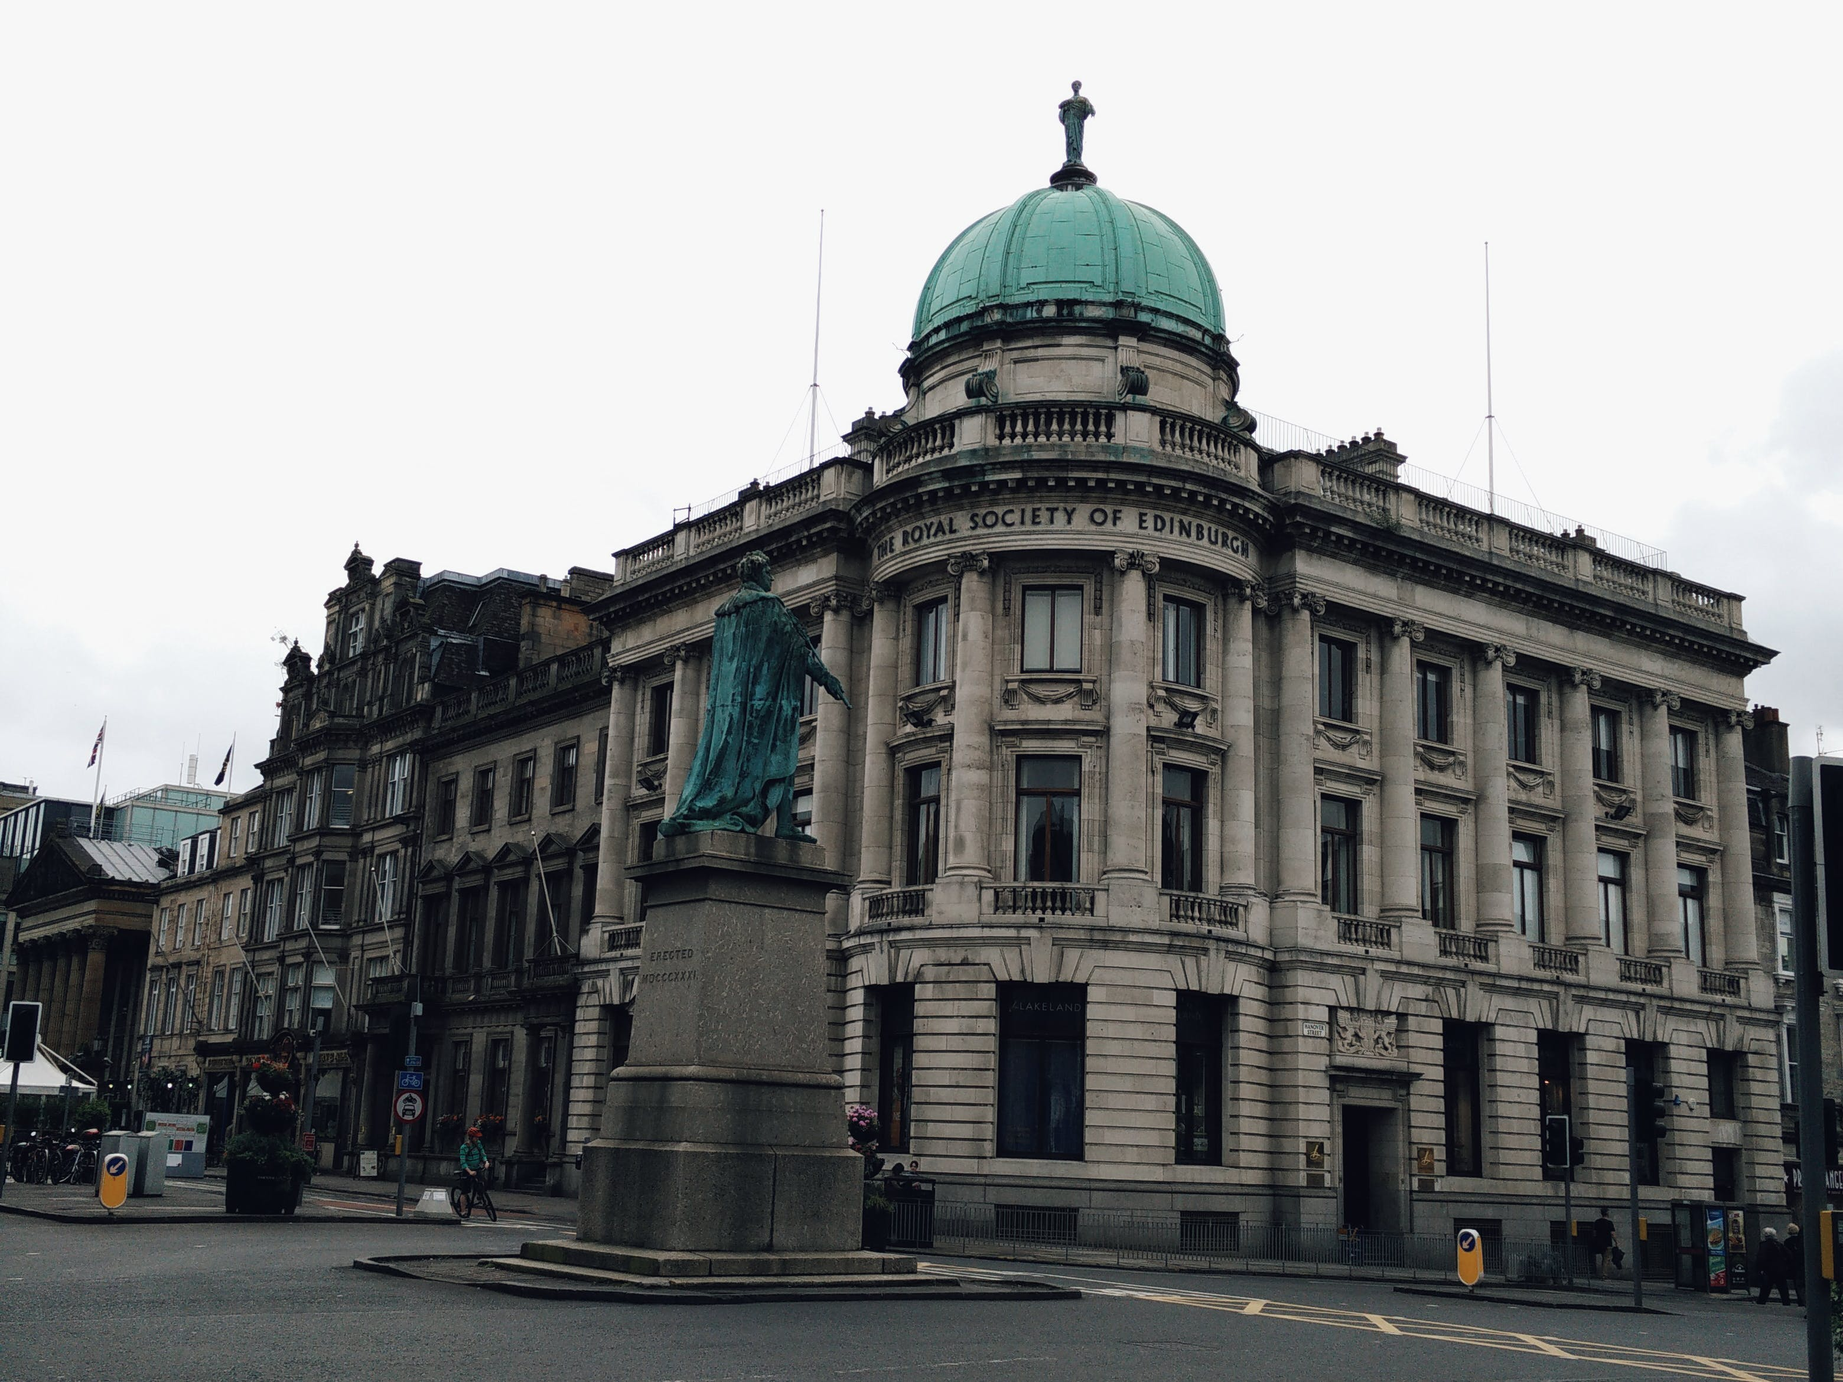
Text
Title Text (Calibri Light 34pt)
Standard text (Calibri standard 24pt)
Calibri Bold (Calibri Bold 24pt) (Only used for highlights en sub-headers)
Calibri Italic (Calibri Italic 24pt)
1st Secondary text (Calibri 20pt)
2nd Secondary text (Calibri 16pt)
Image credits (Calibri Light Italic 24pt) the color may be changed to improve visibility but should not draw attention.
Standard text color is not black but:
Background color is not WHITE but:
#33333 or R=42 G=42 B=42
#FFFFF or R=240 G=240 B=240
Colors
CHANGE IMAGE/PUT IMAGE
On the left you see the color pallette.
Try to use one “extra” color for a presentation or subject!
Colors used in this example presentation are just to show possibilities.
Some combinations will not work!!
When in doubt or if you want help, contact your course team e-learning developer or the NMC
1
If necessary, delete the existing image using the 'Delete' button. Click the icon to insert a new image. (see example below).
the act of defining, or of making something definite, distinct, or clear
2
Select the desired image and click 'Insert'.
Insert
the act of defining, or of making something definite, distinct, or clear
3
To scale or crop the image, go to the 'Picture Tools - Format' tab and click the 'Crop' button. Scale the image the dots and the image frame with the c with corners.
Basic colors
Extra colors
Crop
DO YOU NEED HELP?
Contact your course team e-learning developer or NewMedia Centre!

Slide 55
Text
Title Text (Calibri Light 34pt)
Standard text (Calibri standard 24pt)
Calibri Bold (Calibri Bold 24pt) (Only used for highlights en sub-headers)
Calibri Italic (Calibri Italic 24pt)
1st Secondary text (Calibri 20pt)
2nd Secondary text (Calibri 16pt)
Image credits (Calibri Light Italic 24pt) the color may be changed to improve visibility but should not draw attention.
Standard text color is not black but:
Background color is not WHITE but:
#33333 or R=42 G=42 B=42
#FFFFF or R=240 G=240 B=240
Colors
CHANGE IMAGE/PUT IMAGE
On the left you see the color pallette.
Try to use one “extra” color for a presentation or subject!
Colors used in this example presentation are just to show possibilities.
Some combinations will not work!!
When in doubt or if you want help, contact your course team e-learning developer or the NMC
1
If necessary, delete the existing image using the 'Delete' button. Click the icon to insert a new image. (see example below).
the act of defining, or of making something definite, distinct, or clear
2
Select the desired image and click 'Insert'.
Insert
the act of defining, or of making something definite, distinct, or clear
3
To scale or crop the image, go to the 'Picture Tools - Format' tab and click the 'Crop' button. Scale the image the dots and the image frame with the c with corners.
Basic colors
Extra colors
Crop
DO YOU NEED HELP?
Contact your course team e-learning developer or NewMedia Centre!

Slide 56
Text
Title Text (Calibri Light 34pt)
Standard text (Calibri standard 24pt)
Calibri Bold (Calibri Bold 24pt) (Only used for highlights en sub-headers)
Calibri Italic (Calibri Italic 24pt)
1st Secondary text (Calibri 20pt)
2nd Secondary text (Calibri 16pt)
Image credits (Calibri Light Italic 24pt) the color may be changed to improve visibility but should not draw attention.
Standard text color is not black but:
Background color is not WHITE but:
#33333 or R=42 G=42 B=42
#FFFFF or R=240 G=240 B=240
Colors
CHANGE IMAGE/PUT IMAGE
On the left you see the color pallette.
Try to use one “extra” color for a presentation or subject!
Colors used in this example presentation are just to show possibilities.
Some combinations will not work!!
When in doubt or if you want help, contact your course team e-learning developer or the NMC
1
If necessary, delete the existing image using the 'Delete' button. Click the icon to insert a new image. (see example below).
Keep this short, max 2 sentences
Keep this short, max 2 sentences
2
Select the desired image and click 'Insert'.
Insert
3
To scale or crop the image, go to the 'Picture Tools - Format' tab and click the 'Crop' button. Scale the image the dots and the image frame with the c with corners.
Keep this short, max 2 sentences
Keep this short, max 2 sentences
Basic colors
Extra colors
Crop
DO YOU NEED HELP?
Contact your course team e-learning developer or NewMedia Centre!

Slide 57
Text
Title Text (Calibri Light 34pt)
Standard text (Calibri standard 24pt)
Calibri Bold (Calibri Bold 24pt) (Only used for highlights en sub-headers)
Calibri Italic (Calibri Italic 24pt)
1st Secondary text (Calibri 20pt)
2nd Secondary text (Calibri 16pt)
Image credits (Calibri Light Italic 24pt) the color may be changed to improve visibility but should not draw attention.
Standard text color is not black but:
Background color is not WHITE but:
#33333 or R=42 G=42 B=42
#FFFFF or R=240 G=240 B=240
Colors
CHANGE IMAGE/PUT IMAGE
On the left you see the color pallette.
Try to use one “extra” color for a presentation or subject!
Colors used in this example presentation are just to show possibilities.
Some combinations will not work!!
When in doubt or if you want help, contact your course team e-learning developer or the NMC
Put a title
1
If necessary, delete the existing image using the 'Delete' button. Click the icon to insert a new image. (see example below).
2
Select the desired image and click 'Insert'.
Insert
3
To scale or crop the image, go to the 'Picture Tools - Format' tab and click the 'Crop' button. Scale the image the dots and the image frame with the c with corners.
Basic colors
Extra colors
Crop
DO YOU NEED HELP?
Contact your course team e-learning developer or NewMedia Centre!

Slide 58
Text
Title Text (Calibri Light 34pt)
Standard text (Calibri standard 24pt)
Calibri Bold (Calibri Bold 24pt) (Only used for highlights en sub-headers)
Calibri Italic (Calibri Italic 24pt)
1st Secondary text (Calibri 20pt)
2nd Secondary text (Calibri 16pt)
Image credits (Calibri Light Italic 24pt) the color may be changed to improve visibility but should not draw attention.
Standard text color is not black but:
Background color is not WHITE but:
#33333 or R=42 G=42 B=42
#FFFFF or R=240 G=240 B=240
Colors
CHANGE IMAGE/PUT IMAGE
On the left you see the color pallette.
Try to use one “extra” color for a presentation or subject!
Colors used in this example presentation are just to show possibilities.
Some combinations will not work!!
When in doubt or if you want help, contact your course team e-learning developer or the NMC
1
If necessary, delete the existing image using the 'Delete' button. Click the icon to insert a new image. (see example below).
Images, tables and more
2
Select the desired image and click 'Insert'.
Insert
3
To scale or crop the image, go to the 'Picture Tools - Format' tab and click the 'Crop' button. Scale the image the dots and the image frame with the c with corners.
Basic colors
Extra colors
Crop
DO YOU NEED HELP?
Contact your course team e-learning developer or NewMedia Centre!

Slide 59
Text
Title Text (Calibri Light 34pt)
Standard text (Calibri standard 24pt)
Calibri Bold (Calibri Bold 24pt) (Only used for highlights en sub-headers)
Calibri Italic (Calibri Italic 24pt)
1st Secondary text (Calibri 20pt)
2nd Secondary text (Calibri 16pt)
Image credits (Calibri Light Italic 24pt) the color may be changed to improve visibility but should not draw attention.
Standard text color is not black but:
Background color is not WHITE but:
#33333 or R=42 G=42 B=42
#FFFFF or R=240 G=240 B=240
Colors
CHANGE IMAGE/PUT IMAGE
On the left you see the color pallette.
Try to use one “extra” color for a presentation or subject!
Colors used in this example presentation are just to show possibilities.
Some combinations will not work!!
When in doubt or if you want help, contact your course team e-learning developer or the NMC
1
If necessary, delete the existing image using the 'Delete' button. Click the icon to insert a new image. (see example below).
Quantity
Name
Unit
Name
Unit
Symbol
Dimension
Symbol
Length | Meter | M | L
Mass | Kilogram | Kg | M
Time | Second | S | T
Electric Current | Ampere | A | I
Temperature | Kelvin | K | Θ
Amount Of Subtance | Mole | Mol | N
Luminous Intensity | Candela | cd | J
2
Select the desired image and click 'Insert'.
Insert
3
To scale or crop the image, go to the 'Picture Tools - Format' tab and click the 'Crop' button. Scale the image the dots and the image frame with the c with corners.
Basic colors
Extra colors
Crop
DO YOU NEED HELP?
Contact your course team e-learning developer or NewMedia Centre!

Slide 60
Text
Title Text (Calibri Light 34pt)
Standard text (Calibri standard 24pt)
Calibri Bold (Calibri Bold 24pt) (Only used for highlights en sub-headers)
Calibri Italic (Calibri Italic 24pt)
1st Secondary text (Calibri 20pt)
2nd Secondary text (Calibri 16pt)
Image credits (Calibri Light Italic 24pt) the color may be changed to improve visibility but should not draw attention.
Standard text color is not black but:
Background color is not WHITE but:
#33333 or R=42 G=42 B=42
#FFFFF or R=240 G=240 B=240
Colors
CHANGE IMAGE/PUT IMAGE
On the left you see the color pallette.
Try to use one “extra” color for a presentation or subject!
Colors used in this example presentation are just to show possibilities.
Some combinations will not work!!
When in doubt or if you want help, contact your course team e-learning developer or the NMC
1
If necessary, delete the existing image using the 'Delete' button. Click the icon to insert a new image. (see example below).
Quantity
Name
Unit
Name
Unit
Symbol
Dimension
Symbol
Length | Meter | M | L
Mass | Kilogram | Kg | M
Time | Second | S | T
Electric Current | Ampere | A | I
Temperature | Kelvin | K | Θ
Amount Of Subtance | Mole | Mol | N
Luminous Intensity | Candela | cd | J
2
Select the desired image and click 'Insert'.
Insert
3
To scale or crop the image, go to the 'Picture Tools - Format' tab and click the 'Crop' button. Scale the image the dots and the image frame with the c with corners.
Basic colors
Extra colors
Crop
DO YOU NEED HELP?
Contact your course team e-learning developer or NewMedia Centre!

Slide 61
Text
Title Text (Calibri Light 34pt)
Standard text (Calibri standard 24pt)
Calibri Bold (Calibri Bold 24pt) (Only used for highlights en sub-headers)
Calibri Italic (Calibri Italic 24pt)
1st Secondary text (Calibri 20pt)
2nd Secondary text (Calibri 16pt)
Image credits (Calibri Light Italic 24pt) the color may be changed to improve visibility but should not draw attention.
Standard text color is not black but:
Background color is not WHITE but:
#33333 or R=42 G=42 B=42
#FFFFF or R=240 G=240 B=240
Colors
CHANGE IMAGE/PUT IMAGE
On the left you see the color pallette.
Try to use one “extra” color for a presentation or subject!
Colors used in this example presentation are just to show possibilities.
Some combinations will not work!!
When in doubt or if you want help, contact your course team e-learning developer or the NMC
1
If necessary, delete the existing image using the 'Delete' button. Click the icon to insert a new image. (see example below).
Retain and grow
Measure and optimise
2
Select the desired image and click 'Insert'.
Market Analysis
Insert
3
To scale or crop the image, go to the 'Picture Tools - Format' tab and click the 'Crop' button. Scale the image the dots and the image frame with the c with corners.
Basic colors
Extra colors
Convert
Acquire
Crop
DO YOU NEED HELP?
Contact your course team e-learning developer or NewMedia Centre!

Slide 62
Text
Title Text (Calibri Light 34pt)
Standard text (Calibri standard 24pt)
Calibri Bold (Calibri Bold 24pt) (Only used for highlights en sub-headers)
Calibri Italic (Calibri Italic 24pt)
1st Secondary text (Calibri 20pt)
2nd Secondary text (Calibri 16pt)
Image credits (Calibri Light Italic 24pt) the color may be changed to improve visibility but should not draw attention.
Standard text color is not black but:
Background color is not WHITE but:
#33333 or R=42 G=42 B=42
#FFFFF or R=240 G=240 B=240
Colors
CHANGE IMAGE/PUT IMAGE
On the left you see the color pallette.
Try to use one “extra” color for a presentation or subject!
Colors used in this example presentation are just to show possibilities.
Some combinations will not work!!
When in doubt or if you want help, contact your course team e-learning developer or the NMC
1
If necessary, delete the existing image using the 'Delete' button. Click the icon to insert a new image. (see example below).
Keep it short
Keep it short
2
Select the desired image and click 'Insert'.
Best practise
Insert
3
To scale or crop the image, go to the 'Picture Tools - Format' tab and click the 'Crop' button. Scale the image the dots and the image frame with the c with corners.
Basic colors
Extra colors
Keep it short
Keep it short
Crop
DO YOU NEED HELP?
Contact your course team e-learning developer or NewMedia Centre!

Slide 63
Text
Title Text (Calibri Light 34pt)
Standard text (Calibri standard 24pt)
Calibri Bold (Calibri Bold 24pt) (Only used for highlights en sub-headers)
Calibri Italic (Calibri Italic 24pt)
1st Secondary text (Calibri 20pt)
2nd Secondary text (Calibri 16pt)
Image credits (Calibri Light Italic 24pt) the color may be changed to improve visibility but should not draw attention.
Standard text color is not black but:
Background color is not WHITE but:
#33333 or R=42 G=42 B=42
#FFFFF or R=240 G=240 B=240
Colors
CHANGE IMAGE/PUT IMAGE
On the left you see the color pallette.
Try to use one “extra” color for a presentation or subject!
Colors used in this example presentation are just to show possibilities.
Some combinations will not work!!
When in doubt or if you want help, contact your course team e-learning developer or the NMC
1
If necessary, delete the existing image using the 'Delete' button. Click the icon to insert a new image. (see example below).
Research Lab
Research Lab
2
Select the desired image and click 'Insert'.
Best practise
Insert
Research Lab
Research Lab
3
To scale or crop the image, go to the 'Picture Tools - Format' tab and click the 'Crop' button. Scale the image the dots and the image frame with the c with corners.
Basic colors
Extra colors
Research Lab
Research Lab
Crop
DO YOU NEED HELP?
Contact your course team e-learning developer or NewMedia Centre!

Slide 64
Text
Title Text (Calibri Light 34pt)
Standard text (Calibri standard 24pt)
Calibri Bold (Calibri Bold 24pt) (Only used for highlights en sub-headers)
Calibri Italic (Calibri Italic 24pt)
1st Secondary text (Calibri 20pt)
2nd Secondary text (Calibri 16pt)
Image credits (Calibri Light Italic 24pt) the color may be changed to improve visibility but should not draw attention.
Standard text color is not black but:
Background color is not WHITE but:
#33333 or R=42 G=42 B=42
#FFFFF or R=240 G=240 B=240
Colors
CHANGE IMAGE/PUT IMAGE
On the left you see the color pallette.
Try to use one “extra” color for a presentation or subject!
Colors used in this example presentation are just to show possibilities.
Some combinations will not work!!
When in doubt or if you want help, contact your course team e-learning developer or the NMC
1
If necessary, delete the existing image using the 'Delete' button. Click the icon to insert a new image. (see example below).
1
2
Select the desired image and click 'Insert'.
Put some text here
Insert
2
3
To scale or crop the image, go to the 'Picture Tools - Format' tab and click the 'Crop' button. Scale the image the dots and the image frame with the c with corners.
Basic colors
Extra colors
3
Crop
DO YOU NEED HELP?
Contact your course team e-learning developer or NewMedia Centre!

Slide 65
Text
Title Text (Calibri Light 34pt)
Standard text (Calibri standard 24pt)
Calibri Bold (Calibri Bold 24pt) (Only used for highlights en sub-headers)
Calibri Italic (Calibri Italic 24pt)
1st Secondary text (Calibri 20pt)
2nd Secondary text (Calibri 16pt)
Image credits (Calibri Light Italic 24pt) the color may be changed to improve visibility but should not draw attention.
Standard text color is not black but:
Background color is not WHITE but:
#33333 or R=42 G=42 B=42
#FFFFF or R=240 G=240 B=240
Colors
CHANGE IMAGE/PUT IMAGE
On the left you see the color pallette.
Try to use one “extra” color for a presentation or subject!
Colors used in this example presentation are just to show possibilities.
Some combinations will not work!!
When in doubt or if you want help, contact your course team e-learning developer or the NMC
1
If necessary, delete the existing image using the 'Delete' button. Click the icon to insert a new image. (see example below).
1
Keep
2
Select the desired image and click 'Insert'.
Insert
2
It
3
To scale or crop the image, go to the 'Picture Tools - Format' tab and click the 'Crop' button. Scale the image the dots and the image frame with the c with corners.
Basic colors
Extra colors
3
Short
Crop
DO YOU NEED HELP?
Contact your course team e-learning developer or NewMedia Centre!

Slide 66
Text
Title Text (Calibri Light 34pt)
Standard text (Calibri standard 24pt)
Calibri Bold (Calibri Bold 24pt) (Only used for highlights en sub-headers)
Calibri Italic (Calibri Italic 24pt)
1st Secondary text (Calibri 20pt)
2nd Secondary text (Calibri 16pt)
Image credits (Calibri Light Italic 24pt) the color may be changed to improve visibility but should not draw attention.
Standard text color is not black but:
Background color is not WHITE but:
#33333 or R=42 G=42 B=42
#FFFFF or R=240 G=240 B=240
Colors
CHANGE IMAGE/PUT IMAGE
On the left you see the color pallette.
Try to use one “extra” color for a presentation or subject!
Colors used in this example presentation are just to show possibilities.
Some combinations will not work!!
When in doubt or if you want help, contact your course team e-learning developer or the NMC
1
If necessary, delete the existing image using the 'Delete' button. Click the icon to insert a new image. (see example below).
Best practise
Keep this short
2
Select the desired image and click 'Insert'.
Insert
3
To scale or crop the image, go to the 'Picture Tools - Format' tab and click the 'Crop' button. Scale the image the dots and the image frame with the c with corners.
Keep this short
Basic colors
Extra colors
Keep this short
Crop
DO YOU NEED HELP?
Contact your course team e-learning developer or NewMedia Centre!

Slide 67
Text
Title Text (Calibri Light 34pt)
Standard text (Calibri standard 24pt)
Calibri Bold (Calibri Bold 24pt) (Only used for highlights en sub-headers)
Calibri Italic (Calibri Italic 24pt)
1st Secondary text (Calibri 20pt)
2nd Secondary text (Calibri 16pt)
Image credits (Calibri Light Italic 24pt) the color may be changed to improve visibility but should not draw attention.
Standard text color is not black but:
Background color is not WHITE but:
#33333 or R=42 G=42 B=42
#FFFFF or R=240 G=240 B=240
Colors
CHANGE IMAGE/PUT IMAGE
On the left you see the color pallette.
Try to use one “extra” color for a presentation or subject!
Colors used in this example presentation are just to show possibilities.
Some combinations will not work!!
When in doubt or if you want help, contact your course team e-learning developer or the NMC
1
If necessary, delete the existing image using the 'Delete' button. Click the icon to insert a new image. (see example below).
Best practise
2
Select the desired image and click 'Insert'.
Keep this short
Insert
3
To scale or crop the image, go to the 'Picture Tools - Format' tab and click the 'Crop' button. Scale the image the dots and the image frame with the c with corners.
Keep this short
Basic colors
Extra colors
Crop
DO YOU NEED HELP?
Contact your course team e-learning developer or NewMedia Centre!

Slide 68
Text
Title Text (Calibri Light 34pt)
Standard text (Calibri standard 24pt)
Calibri Bold (Calibri Bold 24pt) (Only used for highlights en sub-headers)
Calibri Italic (Calibri Italic 24pt)
1st Secondary text (Calibri 20pt)
2nd Secondary text (Calibri 16pt)
Image credits (Calibri Light Italic 24pt) the color may be changed to improve visibility but should not draw attention.
Standard text color is not black but:
Background color is not WHITE but:
#33333 or R=42 G=42 B=42
#FFFFF or R=240 G=240 B=240
Colors
CHANGE IMAGE/PUT IMAGE
On the left you see the color pallette.
Try to use one “extra” color for a presentation or subject!
Colors used in this example presentation are just to show possibilities.
Some combinations will not work!!
When in doubt or if you want help, contact your course team e-learning developer or the NMC
1
If necessary, delete the existing image using the 'Delete' button. Click the icon to insert a new image. (see example below).
Best practise
2
Select the desired image and click 'Insert'.
Insert
Keep this short
3
To scale or crop the image, go to the 'Picture Tools - Format' tab and click the 'Crop' button. Scale the image the dots and the image frame with the c with corners.
Basic colors
Extra colors
Keep this short
Crop
DO YOU NEED HELP?
Contact your course team e-learning developer or NewMedia Centre!

Slide 69
Text
Title Text (Calibri Light 34pt)
Standard text (Calibri standard 24pt)
Calibri Bold (Calibri Bold 24pt) (Only used for highlights en sub-headers)
Calibri Italic (Calibri Italic 24pt)
1st Secondary text (Calibri 20pt)
2nd Secondary text (Calibri 16pt)
Image credits (Calibri Light Italic 24pt) the color may be changed to improve visibility but should not draw attention.
Standard text color is not black but:
Background color is not WHITE but:
#33333 or R=42 G=42 B=42
#FFFFF or R=240 G=240 B=240
Colors
CHANGE IMAGE/PUT IMAGE
On the left you see the color pallette.
Try to use one “extra” color for a presentation or subject!
Colors used in this example presentation are just to show possibilities.
Some combinations will not work!!
When in doubt or if you want help, contact your course team e-learning developer or the NMC
1
If necessary, delete the existing image using the 'Delete' button. Click the icon to insert a new image. (see example below).
2
Select the desired image and click 'Insert'.
Insert
3
To scale or crop the image, go to the 'Picture Tools - Format' tab and click the 'Crop' button. Scale the image the dots and the image frame with the c with corners.
Basic colors
Extra colors
Crop
DO YOU NEED HELP?
Contact your course team e-learning developer or NewMedia Centre!

Slide 70
Text
Title Text (Calibri Light 34pt)
Standard text (Calibri standard 24pt)
Calibri Bold (Calibri Bold 24pt) (Only used for highlights en sub-headers)
Calibri Italic (Calibri Italic 24pt)
1st Secondary text (Calibri 20pt)
2nd Secondary text (Calibri 16pt)
Image credits (Calibri Light Italic 24pt) the color may be changed to improve visibility but should not draw attention.
Standard text color is not black but:
Background color is not WHITE but:
#33333 or R=42 G=42 B=42
#FFFFF or R=240 G=240 B=240
Colors
CHANGE IMAGE/PUT IMAGE
On the left you see the color pallette.
Try to use one “extra” color for a presentation or subject!
Colors used in this example presentation are just to show possibilities.
Some combinations will not work!!
When in doubt or if you want help, contact your course team e-learning developer or the NMC
1
If necessary, delete the existing image using the 'Delete' button. Click the icon to insert a new image. (see example below).
2
Select the desired image and click 'Insert'.
Insert
3
To scale or crop the image, go to the 'Picture Tools - Format' tab and click the 'Crop' button. Scale the image the dots and the image frame with the c with corners.
Basic colors
Extra colors
Crop
DO YOU NEED HELP?
Contact your course team e-learning developer or NewMedia Centre!

Slide 71

Text
Title Text (Calibri Light 34pt)
Standard text (Calibri standard 24pt)
Calibri Bold (Calibri Bold 24pt) (Only used for highlights en sub-headers)
Calibri Italic (Calibri Italic 24pt)
1st Secondary text (Calibri 20pt)
2nd Secondary text (Calibri 16pt)
Image credits (Calibri Light Italic 24pt) the color may be changed to improve visibility but should not draw attention.
Standard text color is not black but:
Background color is not WHITE but:
#33333 or R=42 G=42 B=42
#FFFFF or R=240 G=240 B=240
Colors
CHANGE IMAGE/PUT IMAGE
On the left you see the color pallette.
Try to use one “extra” color for a presentation or subject!
Colors used in this example presentation are just to show possibilities.
Some combinations will not work!!
When in doubt or if you want help, contact your course team e-learning developer or the NMC
1
If necessary, delete the existing image using the 'Delete' button. Click the icon to insert a new image. (see example below).
Best practise
2
Select the desired image and click 'Insert'.
Keep this short
Keep this short
Insert
3
To scale or crop the image, go to the 'Picture Tools - Format' tab and click the 'Crop' button. Scale the image the dots and the image frame with the c with corners.
Keep this short
Keep this short
Basic colors
Extra colors
Crop
DO YOU NEED HELP?
Contact your course team e-learning developer or NewMedia Centre!

Slide 72
Text
Title Text (Calibri Light 34pt)
Standard text (Calibri standard 24pt)
Calibri Bold (Calibri Bold 24pt) (Only used for highlights en sub-headers)
Calibri Italic (Calibri Italic 24pt)
1st Secondary text (Calibri 20pt)
2nd Secondary text (Calibri 16pt)
Image credits (Calibri Light Italic 24pt) the color may be changed to improve visibility but should not draw attention.
Standard text color is not black but:
Background color is not WHITE but:
#33333 or R=42 G=42 B=42
#FFFFF or R=240 G=240 B=240
Colors
CHANGE IMAGE/PUT IMAGE
On the left you see the color pallette.
Try to use one “extra” color for a presentation or subject!
Colors used in this example presentation are just to show possibilities.
Some combinations will not work!!
When in doubt or if you want help, contact your course team e-learning developer or the NMC
1
If necessary, delete the existing image using the 'Delete' button. Click the icon to insert a new image. (see example below).
This is a short list and keep it short
2
Select the desired image and click 'Insert'.
Keep this short
Insert
3
To scale or crop the image, go to the 'Picture Tools - Format' tab and click the 'Crop' button. Scale the image the dots and the image frame with the c with corners.
Keep this short
Basic colors
Extra colors
Crop
Keep this short
DO YOU NEED HELP?
Contact your course team e-learning developer or NewMedia Centre!

Slide 73
Text
Title Text (Calibri Light 34pt)
Standard text (Calibri standard 24pt)
Calibri Bold (Calibri Bold 24pt) (Only used for highlights en sub-headers)
Calibri Italic (Calibri Italic 24pt)
1st Secondary text (Calibri 20pt)
2nd Secondary text (Calibri 16pt)
Image credits (Calibri Light Italic 24pt) the color may be changed to improve visibility but should not draw attention.
Standard text color is not black but:
Background color is not WHITE but:
#33333 or R=42 G=42 B=42
#FFFFF or R=240 G=240 B=240
Colors
CHANGE IMAGE/PUT IMAGE
On the left you see the color pallette.
Try to use one “extra” color for a presentation or subject!
Colors used in this example presentation are just to show possibilities.
Some combinations will not work!!
When in doubt or if you want help, contact your course team e-learning developer or the NMC
1
If necessary, delete the existing image using the 'Delete' button. Click the icon to insert a new image. (see example below).
Keep this short
2
Select the desired image and click 'Insert'.
This is a short list and keep it short
Insert
Keep this short
3
To scale or crop the image, go to the 'Picture Tools - Format' tab and click the 'Crop' button. Scale the image the dots and the image frame with the c with corners.
Basic colors
Extra colors
Keep this short
Crop
DO YOU NEED HELP?
Contact your course team e-learning developer or NewMedia Centre!

Slide 74
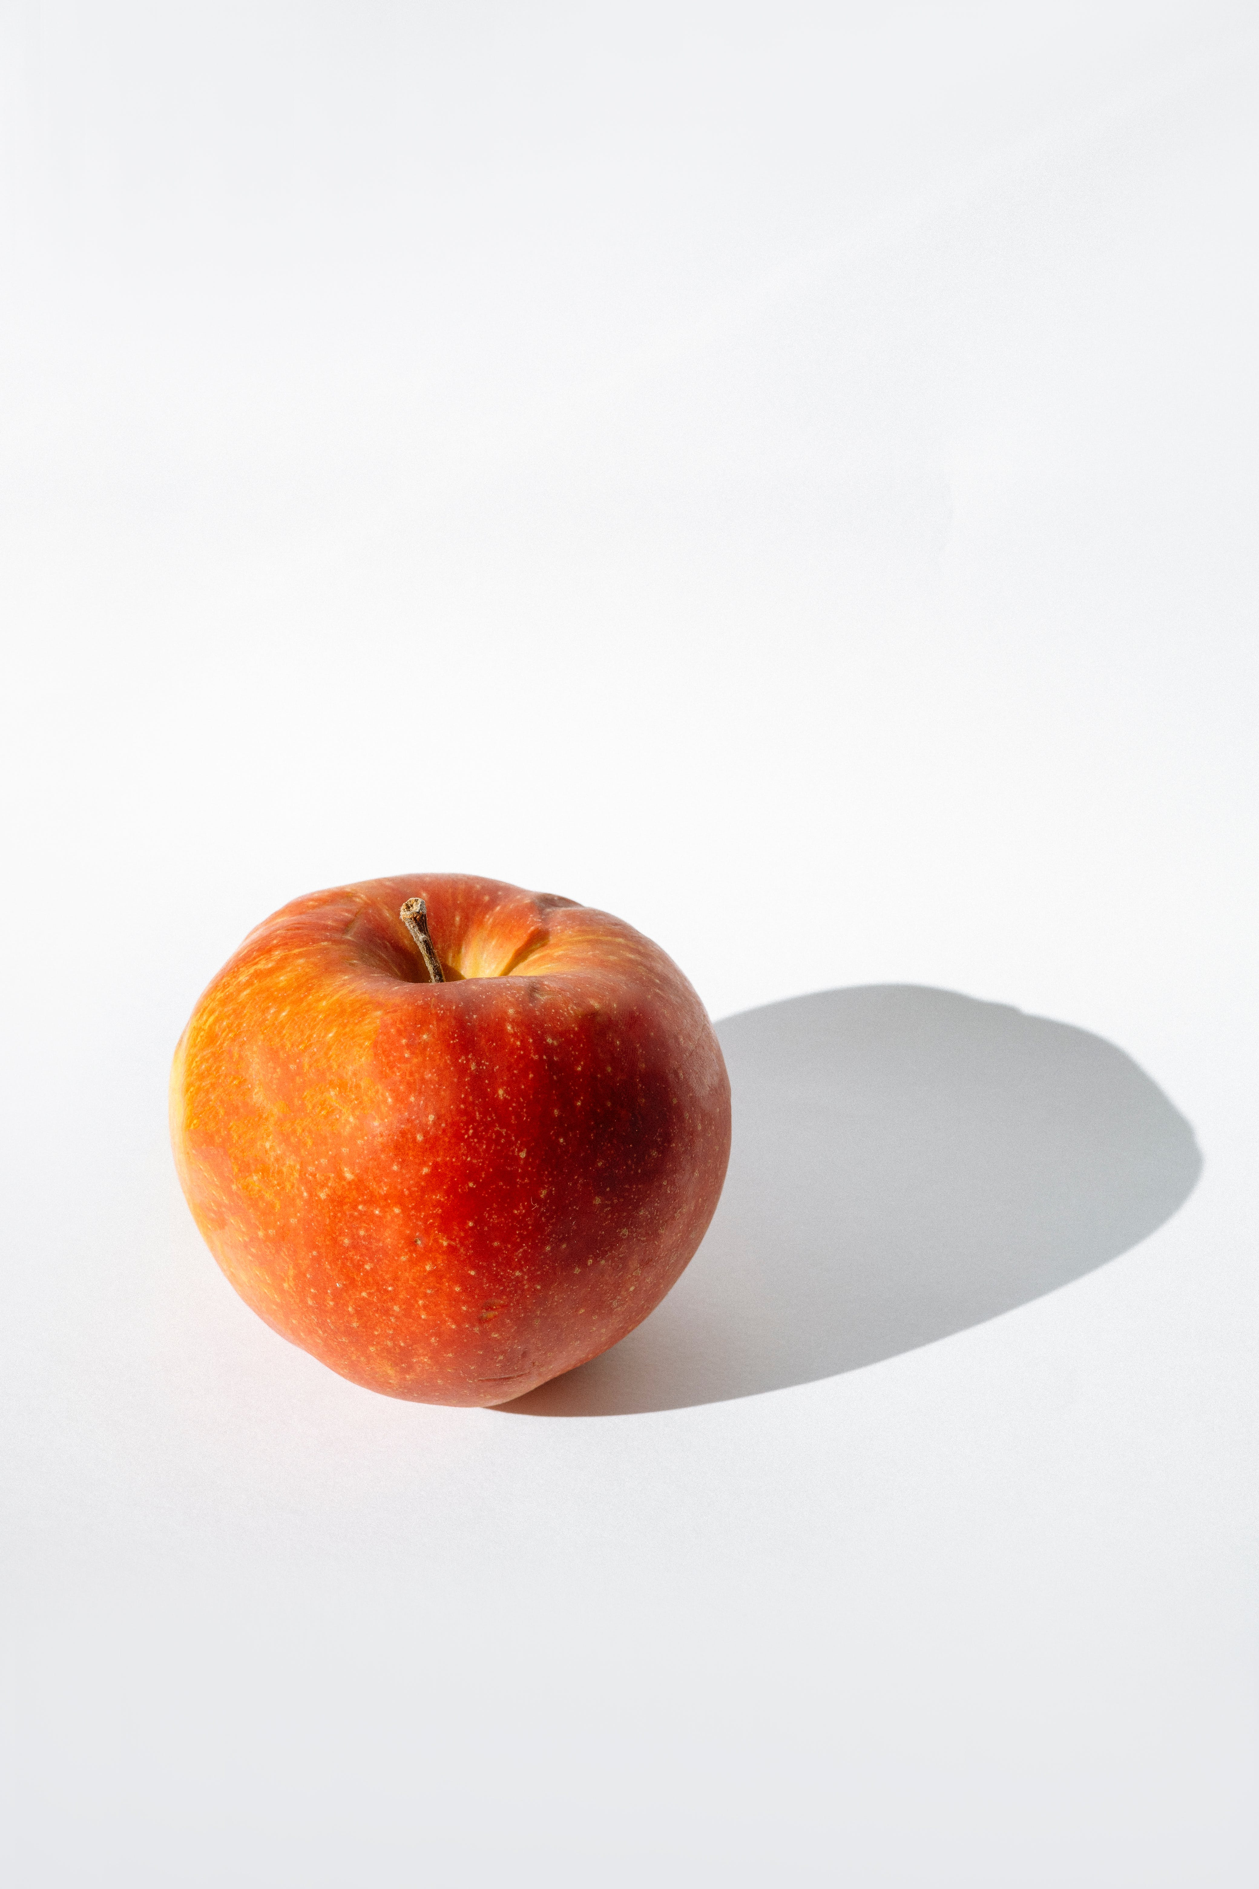
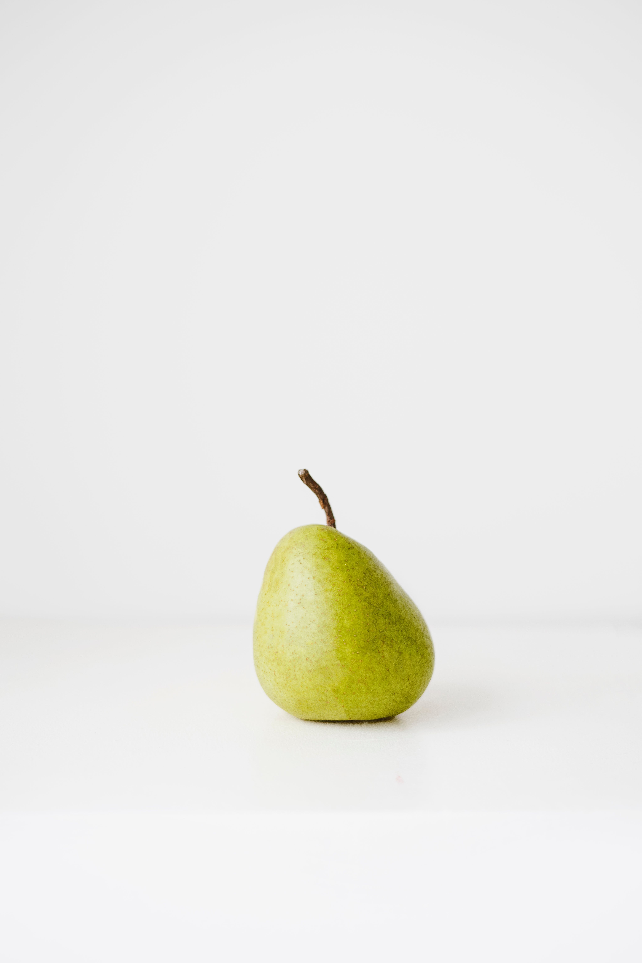
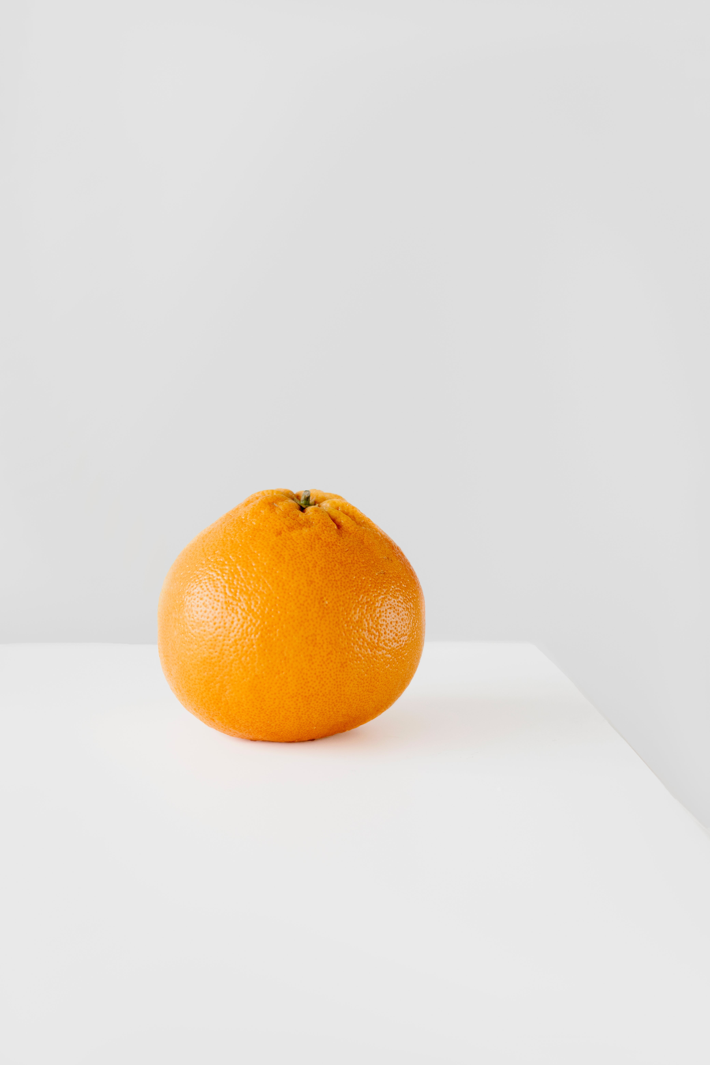
Images for comparison
Text
Title Text (Calibri Light 34pt)
Standard text (Calibri standard 24pt)
Calibri Bold (Calibri Bold 24pt) (Only used for highlights en sub-headers)
Calibri Italic (Calibri Italic 24pt)
1st Secondary text (Calibri 20pt)
2nd Secondary text (Calibri 16pt)
Image credits (Calibri Light Italic 24pt) the color may be changed to improve visibility but should not draw attention.
Standard text color is not black but:
Background color is not WHITE but:
#33333 or R=42 G=42 B=42
#FFFFF or R=240 G=240 B=240
Colors
CHANGE IMAGE/PUT IMAGE
On the left you see the color pallette.
Try to use one “extra” color for a presentation or subject!
Colors used in this example presentation are just to show possibilities.
Some combinations will not work!!
When in doubt or if you want help, contact your course team e-learning developer or the NMC
1
If necessary, delete the existing image using the 'Delete' button. Click the icon to insert a new image. (see example below).
2
Select the desired image and click 'Insert'.
Insert
3
To scale or crop the image, go to the 'Picture Tools - Format' tab and click the 'Crop' button. Scale the image the dots and the image frame with the c with corners.
Basic colors
Extra colors
Crop
DO YOU NEED HELP?
Contact your course team e-learning developer or NewMedia Centre!

Slide 75
Images for comparison
Text
Title Text (Calibri Light 34pt)
Standard text (Calibri standard 24pt)
Calibri Bold (Calibri Bold 24pt) (Only used for highlights en sub-headers)
Calibri Italic (Calibri Italic 24pt)
1st Secondary text (Calibri 20pt)
2nd Secondary text (Calibri 16pt)
Image credits (Calibri Light Italic 24pt) the color may be changed to improve visibility but should not draw attention.
Standard text color is not black but:
Background color is not WHITE but:
#33333 or R=42 G=42 B=42
#FFFFF or R=240 G=240 B=240
Colors
CHANGE IMAGE/PUT IMAGE
On the left you see the color pallette.
Try to use one “extra” color for a presentation or subject!
Colors used in this example presentation are just to show possibilities.
Some combinations will not work!!
When in doubt or if you want help, contact your course team e-learning developer or the NMC
1
If necessary, delete the existing image using the 'Delete' button. Click the icon to insert a new image. (see example below).
2
Select the desired image and click 'Insert'.
Insert
3
To scale or crop the image, go to the 'Picture Tools - Format' tab and click the 'Crop' button. Scale the image the dots and the image frame with the c with corners.
Basic colors
Extra colors
Crop
DO YOU NEED HELP?
Contact your course team e-learning developer or NewMedia Centre!

Slide 76
Images for comparison
Text
Title Text (Calibri Light 34pt)
Standard text (Calibri standard 24pt)
Calibri Bold (Calibri Bold 24pt) (Only used for highlights en sub-headers)
Calibri Italic (Calibri Italic 24pt)
1st Secondary text (Calibri 20pt)
2nd Secondary text (Calibri 16pt)
Image credits (Calibri Light Italic 24pt) the color may be changed to improve visibility but should not draw attention.
Standard text color is not black but:
Background color is not WHITE but:
#33333 or R=42 G=42 B=42
#FFFFF or R=240 G=240 B=240
Colors
CHANGE IMAGE/PUT IMAGE
On the left you see the color pallette.
Try to use one “extra” color for a presentation or subject!
Colors used in this example presentation are just to show possibilities.
Some combinations will not work!!
When in doubt or if you want help, contact your course team e-learning developer or the NMC
1
If necessary, delete the existing image using the 'Delete' button. Click the icon to insert a new image. (see example below).
2
Select the desired image and click 'Insert'.
Insert
3
To scale or crop the image, go to the 'Picture Tools - Format' tab and click the 'Crop' button. Scale the image the dots and the image frame with the c with corners.
Basic colors
Extra colors
Crop
DO YOU NEED HELP?
Contact your course team e-learning developer or NewMedia Centre!

Slide 77
Text
Title Text (Calibri Light 34pt)
Standard text (Calibri standard 24pt)
Calibri Bold (Calibri Bold 24pt) (Only used for highlights en sub-headers)
Calibri Italic (Calibri Italic 24pt)
1st Secondary text (Calibri 20pt)
2nd Secondary text (Calibri 16pt)
Image credits (Calibri Light Italic 24pt) the color may be changed to improve visibility but should not draw attention.
Standard text color is not black but:
Background color is not WHITE but:
#33333 or R=42 G=42 B=42
#FFFFF or R=240 G=240 B=240
Colors
CHANGE IMAGE/PUT IMAGE
On the left you see the color pallette.
Try to use one “extra” color for a presentation or subject!
Colors used in this example presentation are just to show possibilities.
Some combinations will not work!!
When in doubt or if you want help, contact your course team e-learning developer or the NMC
1
If necessary, delete the existing image using the 'Delete' button. Click the icon to insert a new image. (see example below).
2
Select the desired image and click 'Insert'.
Insert
3
To scale or crop the image, go to the 'Picture Tools - Format' tab and click the 'Crop' button. Scale the image the dots and the image frame with the c with corners.
Basic colors
Extra colors
Crop
DO YOU NEED HELP?
Contact your course team e-learning developer or NewMedia Centre!
Photo credits: Pexels.com | foc foodoncam

Slide 78
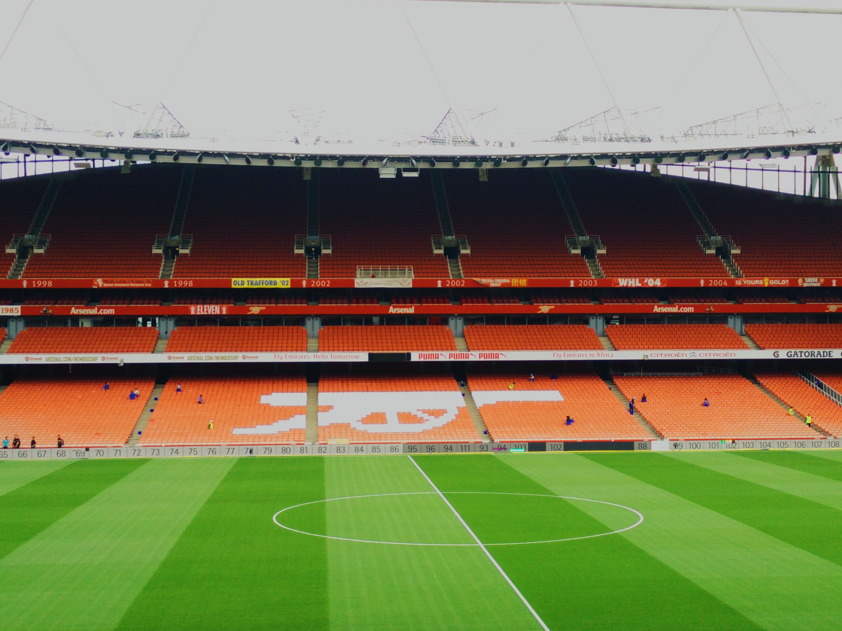
Text
Title Text (Calibri Light 34pt)
Standard text (Calibri standard 24pt)
Calibri Bold (Calibri Bold 24pt) (Only used for highlights en sub-headers)
Calibri Italic (Calibri Italic 24pt)
1st Secondary text (Calibri 20pt)
2nd Secondary text (Calibri 16pt)
Image credits (Calibri Light Italic 24pt) the color may be changed to improve visibility but should not draw attention.
Standard text color is not black but:
Background color is not WHITE but:
#33333 or R=42 G=42 B=42
#FFFFF or R=240 G=240 B=240
Colors
CHANGE IMAGE/PUT IMAGE
On the left you see the color pallette.
Try to use one “extra” color for a presentation or subject!
Colors used in this example presentation are just to show possibilities.
Some combinations will not work!!
When in doubt or if you want help, contact your course team e-learning developer or the NMC
1
If necessary, delete the existing image using the 'Delete' button. Click the icon to insert a new image. (see example below).
2
Select the desired image and click 'Insert'.
Add a sentence
Insert
3
To scale or crop the image, go to the 'Picture Tools - Format' tab and click the 'Crop' button. Scale the image the dots and the image frame with the c with corners.
Basic colors
Extra colors
Crop
DO YOU NEED HELP?
Contact your course team e-learning developer or NewMedia Centre!
Photo credits: Pexels.com | foc foodoncam

Slide 79
Text
Title Text (Calibri Light 34pt)
Standard text (Calibri standard 24pt)
Calibri Bold (Calibri Bold 24pt) (Only used for highlights en sub-headers)
Calibri Italic (Calibri Italic 24pt)
1st Secondary text (Calibri 20pt)
2nd Secondary text (Calibri 16pt)
Image credits (Calibri Light Italic 24pt) the color may be changed to improve visibility but should not draw attention.
Standard text color is not black but:
Background color is not WHITE but:
#33333 or R=42 G=42 B=42
#FFFFF or R=240 G=240 B=240
Colors
CHANGE IMAGE/PUT IMAGE
On the left you see the color pallette.
Try to use one “extra” color for a presentation or subject!
Colors used in this example presentation are just to show possibilities.
Some combinations will not work!!
When in doubt or if you want help, contact your course team e-learning developer or the NMC
1
If necessary, delete the existing image using the 'Delete' button. Click the icon to insert a new image. (see example below).
2
Select the desired image and click 'Insert'.
Insert
3
To scale or crop the image, go to the 'Picture Tools - Format' tab and click the 'Crop' button. Scale the image the dots and the image frame with the c with corners.
Basic colors
Extra colors
Crop
DO YOU NEED HELP?
Contact your course team e-learning developer or NewMedia Centre!

Slide 80
Text
Title Text (Calibri Light 34pt)
Standard text (Calibri standard 24pt)
Calibri Bold (Calibri Bold 24pt) (Only used for highlights en sub-headers)
Calibri Italic (Calibri Italic 24pt)
1st Secondary text (Calibri 20pt)
2nd Secondary text (Calibri 16pt)
Image credits (Calibri Light Italic 24pt) the color may be changed to improve visibility but should not draw attention.
Standard text color is not black but:
Background color is not WHITE but:
#33333 or R=42 G=42 B=42
#FFFFF or R=240 G=240 B=240
Colors
CHANGE IMAGE/PUT IMAGE
On the left you see the color pallette.
Try to use one “extra” color for a presentation or subject!
Colors used in this example presentation are just to show possibilities.
Some combinations will not work!!
When in doubt or if you want help, contact your course team e-learning developer or the NMC
1
If necessary, delete the existing image using the 'Delete' button. Click the icon to insert a new image. (see example below).
2
Select the desired image and click 'Insert'.
Insert
3
To scale or crop the image, go to the 'Picture Tools - Format' tab and click the 'Crop' button. Scale the image the dots and the image frame with the c with corners.
Basic colors
Extra colors
Crop
DO YOU NEED HELP?
Contact your course team e-learning developer or NewMedia Centre!

